Slide 1
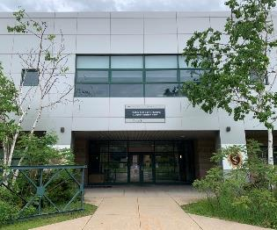
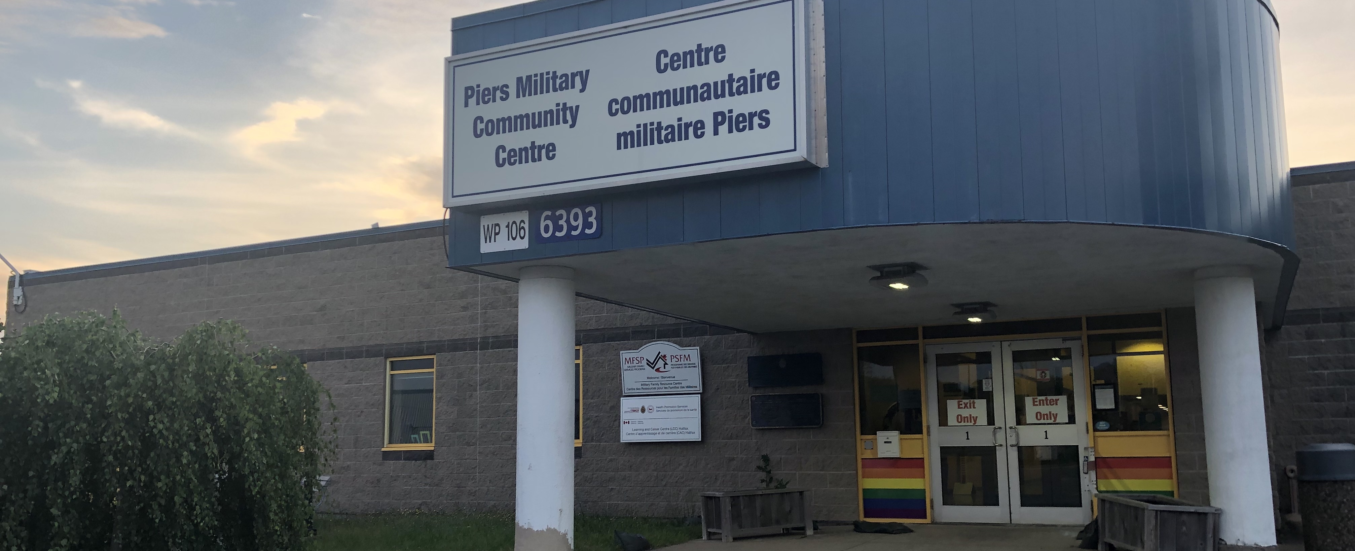
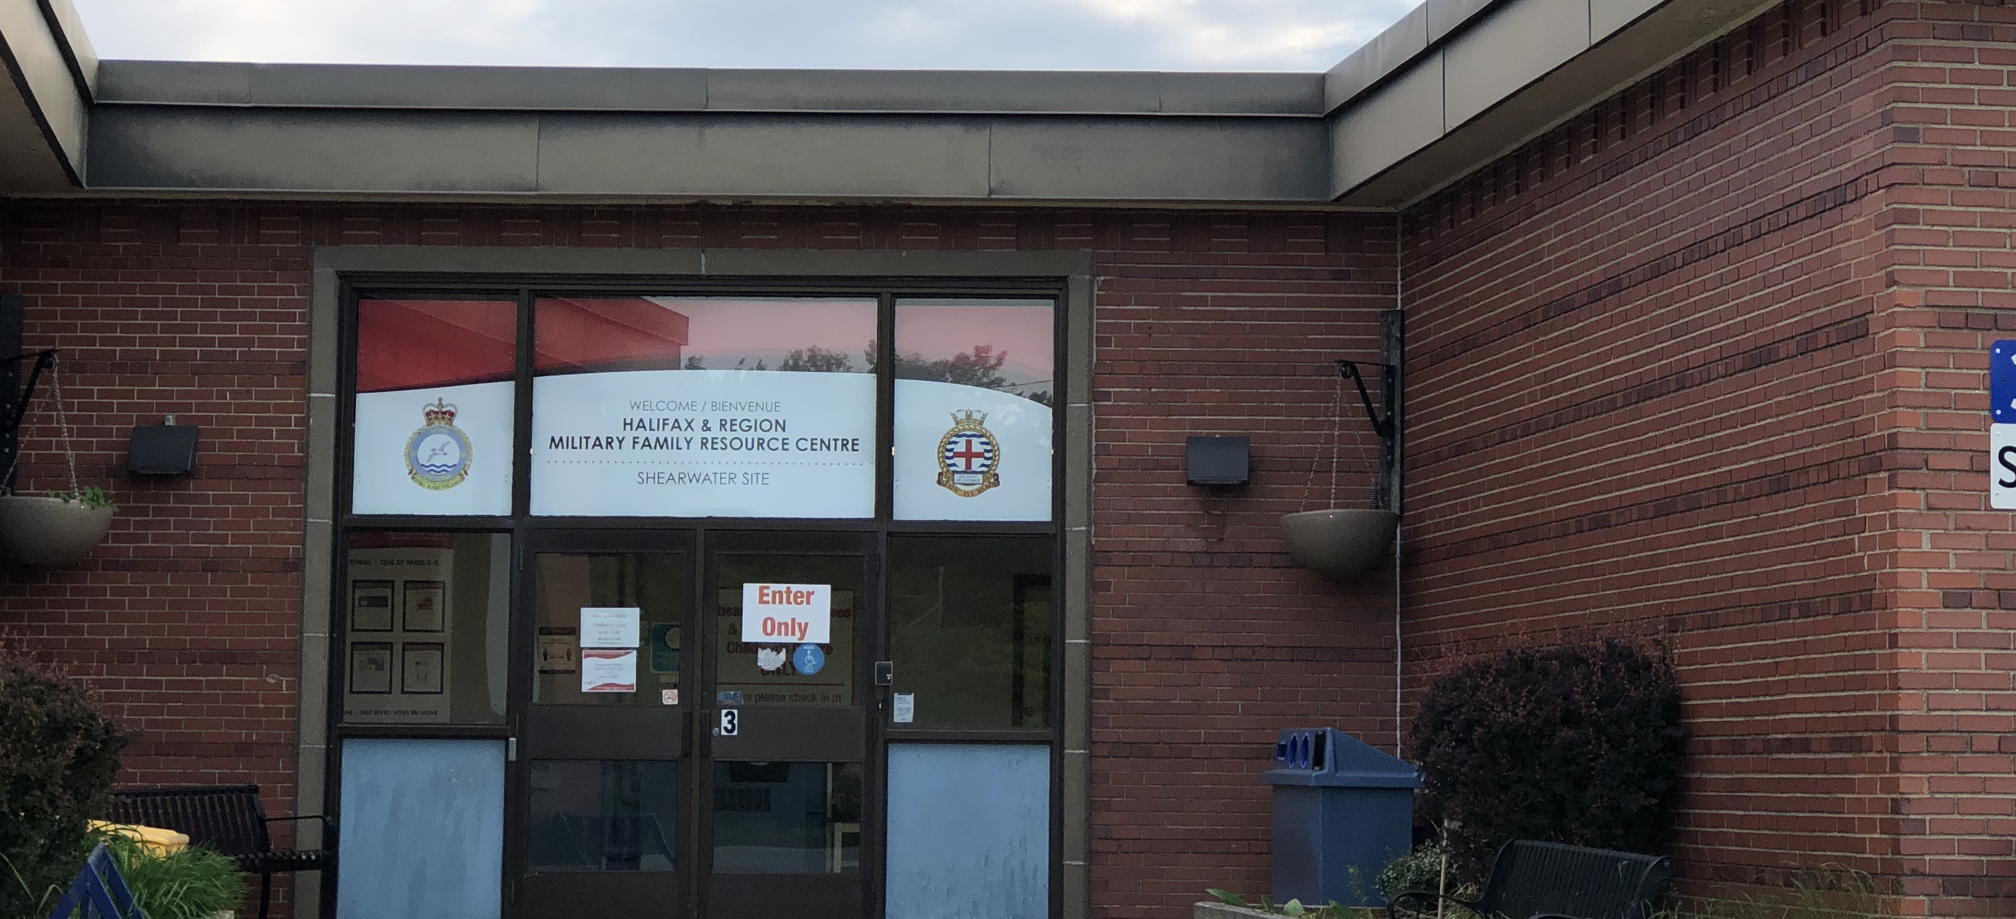
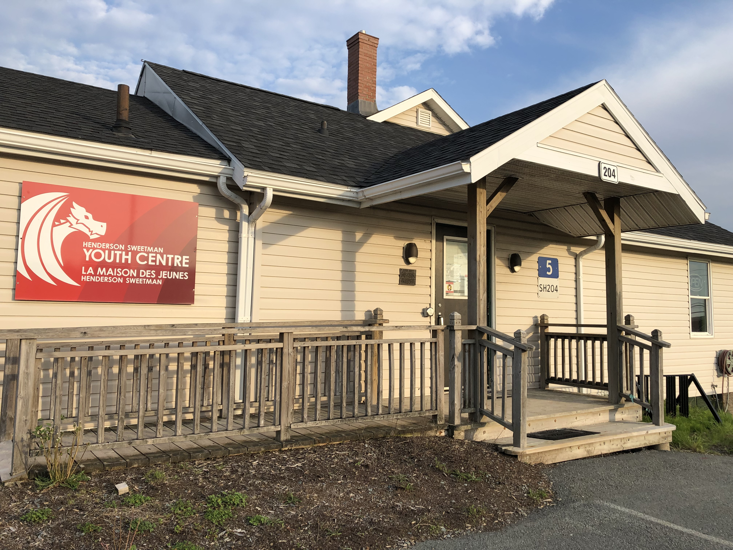
Halifax & Region
Military Family Resource Centre

Slide 2

Indigenous Land Acknowledgment
We would like to acknowledge that we are in Mi’kma’ki (MEEG_MA_GEE), the ancestral territory of the Mi’kmaq people. This territory is covered by the Treaties of Peace and Friendship.
We are all Treaty People.
Land acknowledgments are the beginning place in honoring broken treaty relationships.

Slide 3
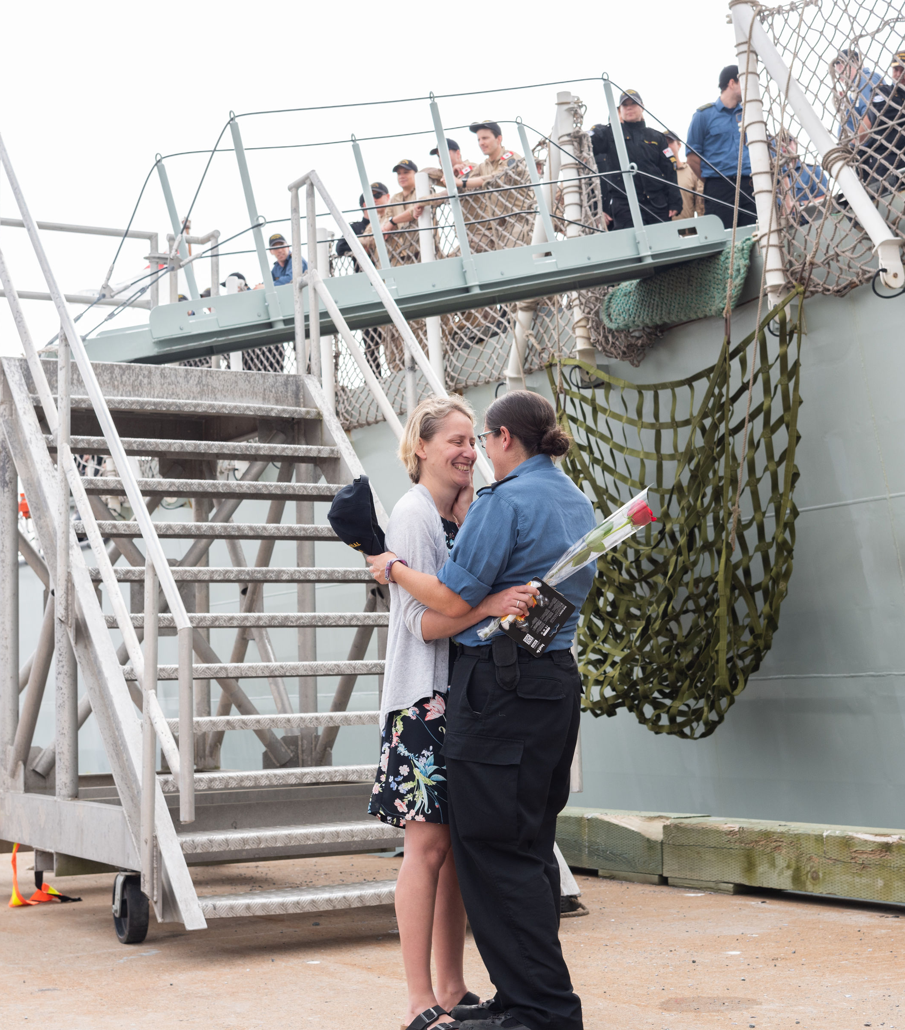
MISSION STATEMENT
To strengthen the
well-being of all those who share the unique experience of military life.

Slide 4
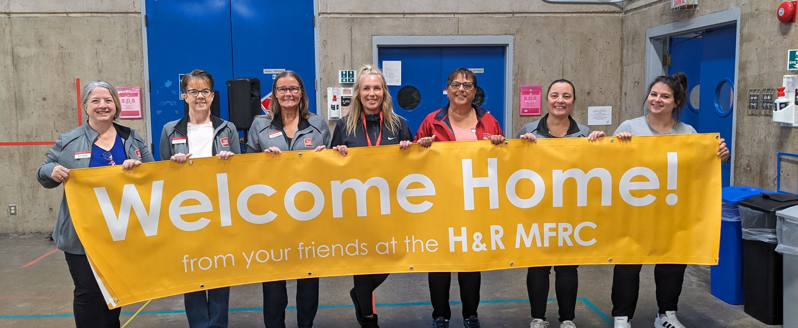
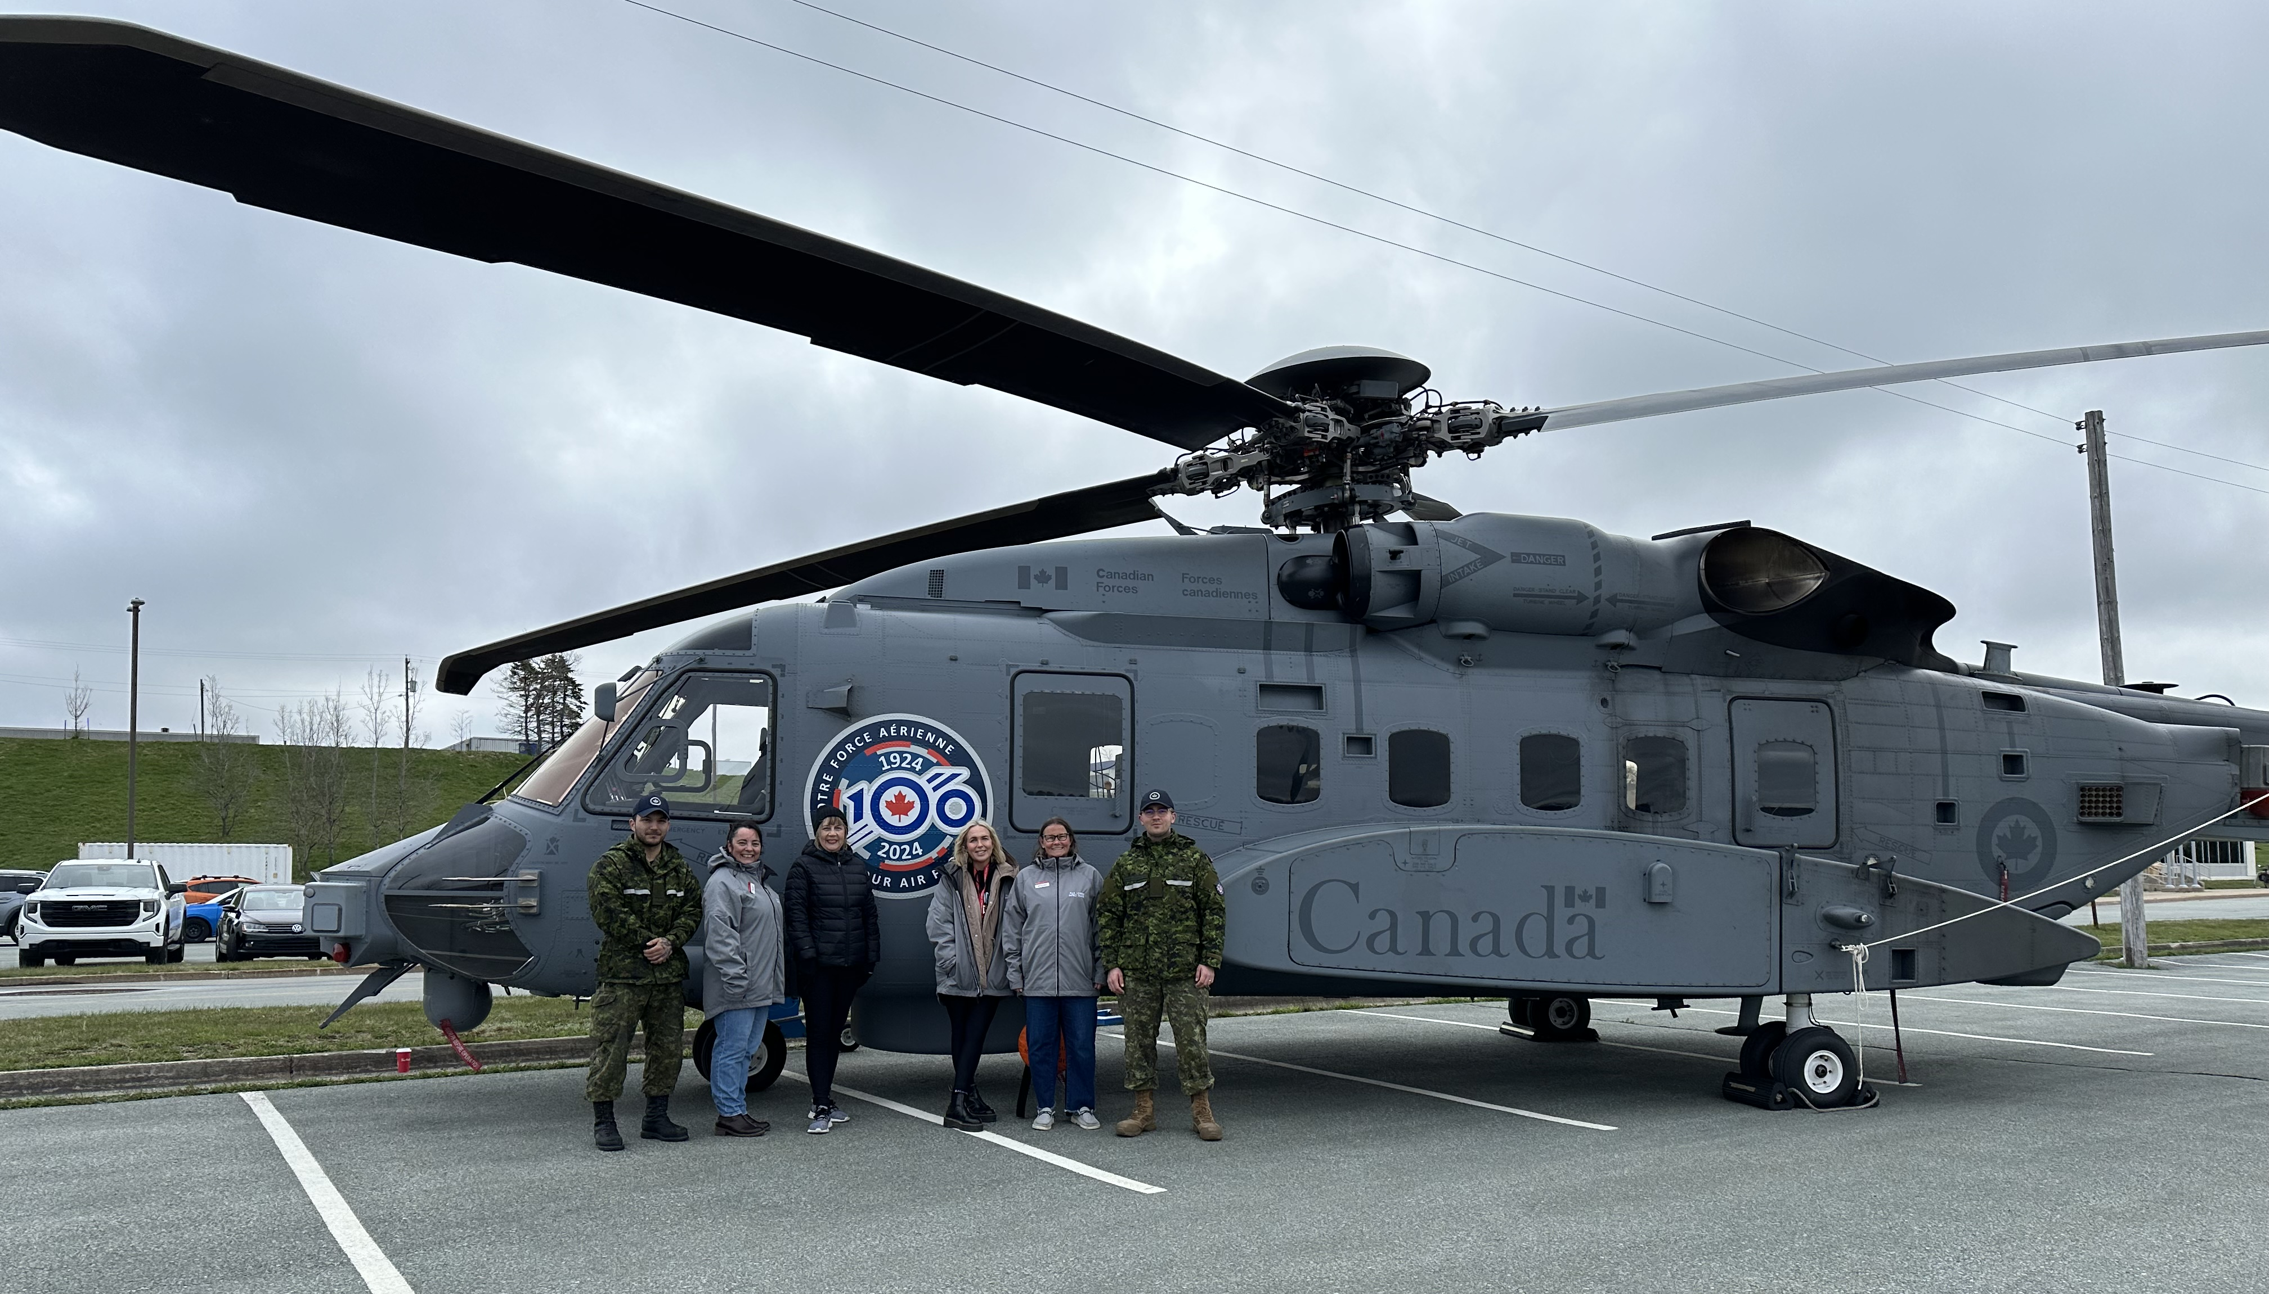
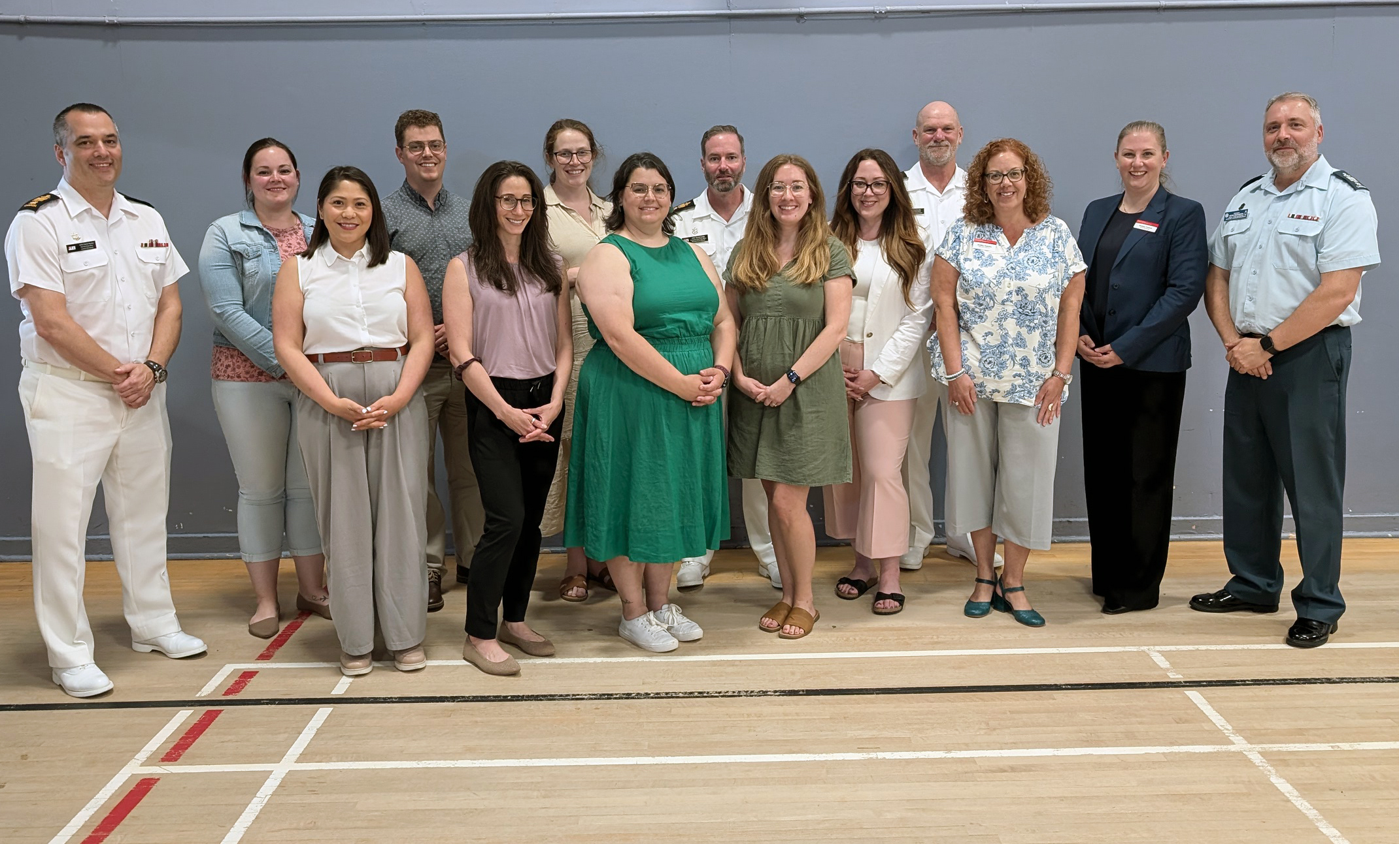


Slide 5
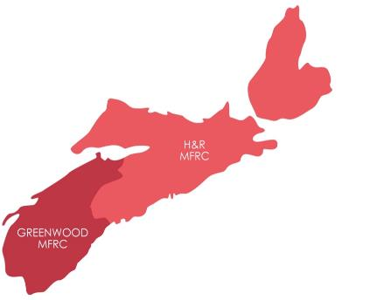



WHERE WE SERVE
SYDNEY SITE
SHEARWATER SITE
HALIFAX SITE

Slide 6
UNIQUE CHARACTERISTICS
Absences
Programs & services that connect families and decrease social isolation.
Relocation
Programs & services that support relocation and community integration
Transitions
Programs & services that ease the process of transition.

Slide 7

What does it mean to you?

Slide 8

OUR DEFINITION
The CAF member
(Reg Force & Reservist)
Veterans
  Spouse / Partner
Parents
Children
Relatives
Anyone you consider family

Slide 9
FAMILY-CENTRED APPROACH
Support is tailored to each situation
Support is collaborative with the family members
We will navigate to local, relevant resources

Slide 10

WE SEEK YOUR FEEDBACK
AND TAKE AN
EVIDENCE BASED
APPROACH

Slide 11

INFORMATION & AWARENESS
24/7 info & referral line, website
& social media
Morale mail drop off
Connection programs
Unit Family Representative program
Sending with love.

Slide 12

WE ARE
MILITARY FAMILY NAVIGATORS

Slide 13

NAVIGATIONAL SUPPORT
Relocation
Resources (finding a doctor, housing)
Outreach in the community
Career & Employment Support
Diverse Needs and Inclusion
Youth Centre

Slide 14
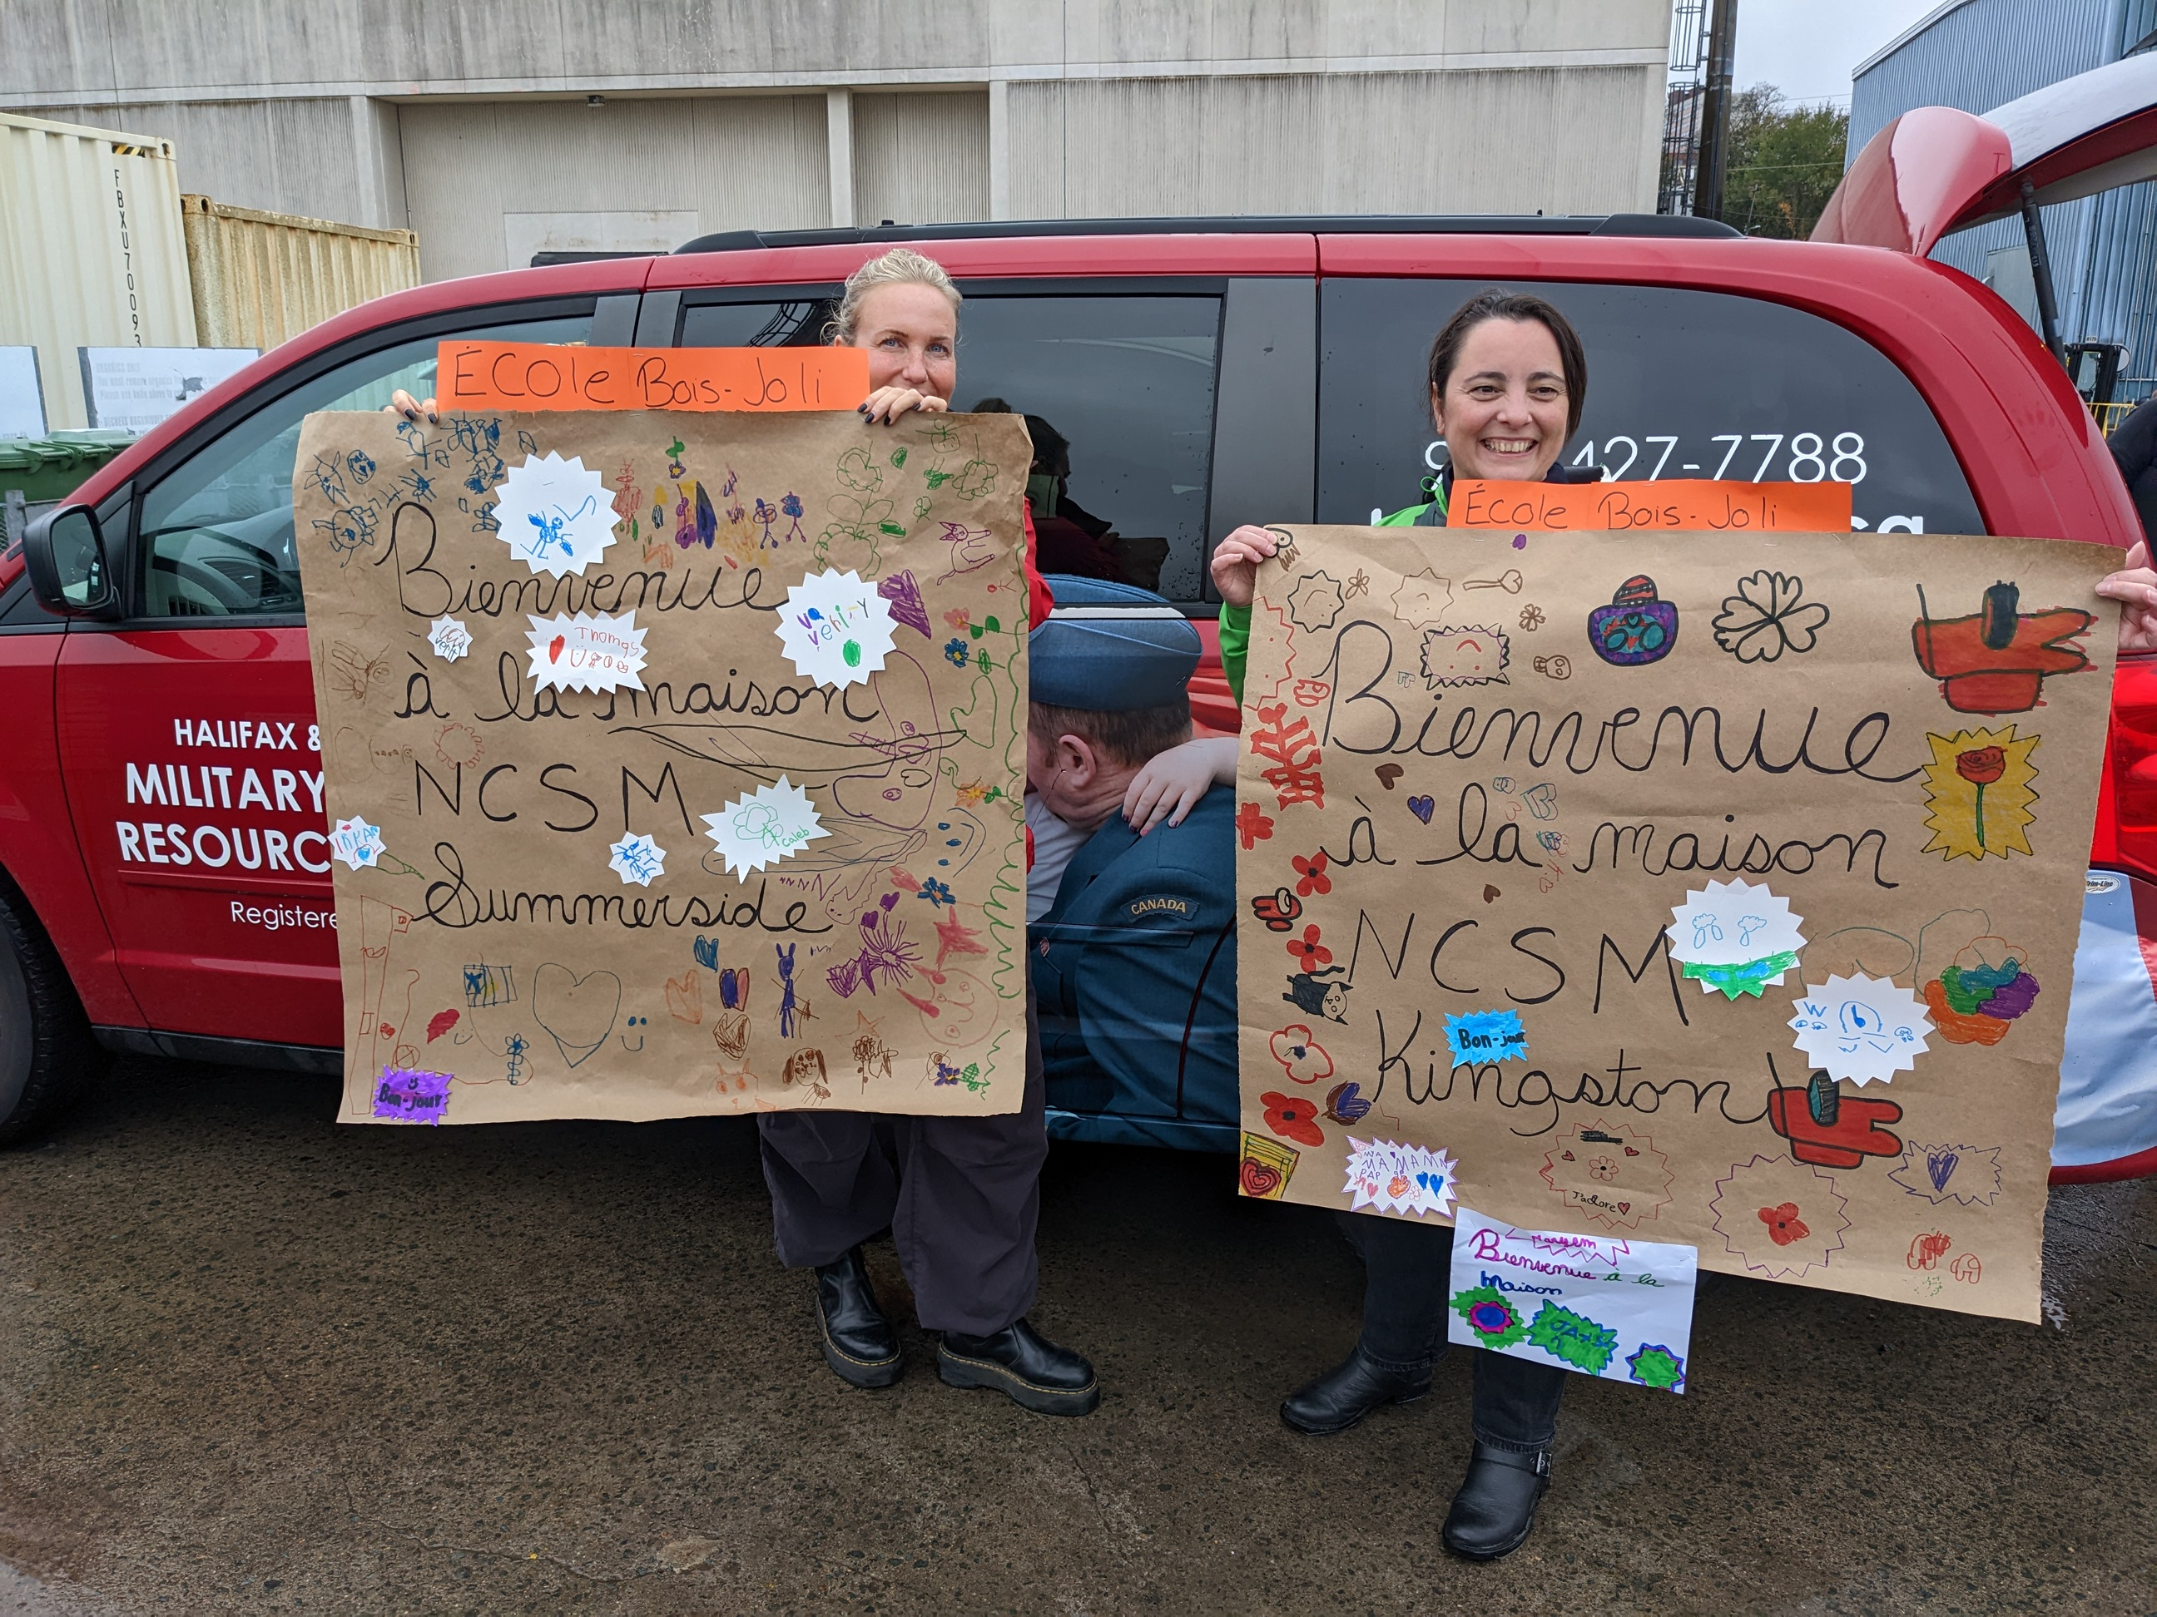
NAVIGATIONAL SUPPORT
Absences / Deployment
Warm-line/check-in calls
Deployment education
Social activities & connections
Morale Mail
Facebook Groups

Slide 15

NAVIGATIONAL SUPPORT
Transitions
Military 101
Parents of CAF Social
Veteran Family Navigator
Family Liaison Counsellor

Slide 16

INTERVENTION
(Mental Health & Well-Being)
Short-term counselling (ages 16+) & Crisis Intervention
Family and Peer Support
Short-term accommodations
Financial resources/OP Dasher
Francophone Counsellor
Navigator support to families with diverse needs
Emergency Family Care Assistance

Slide 17

FUNDING
CHARITY OF CHOICE: NDWCC
Independent non-profit with funding through:
Military Family Service (CFMWS)
Base/Wing
Fundraising/Donations and Sponsorship
Program Fees

Slide 18


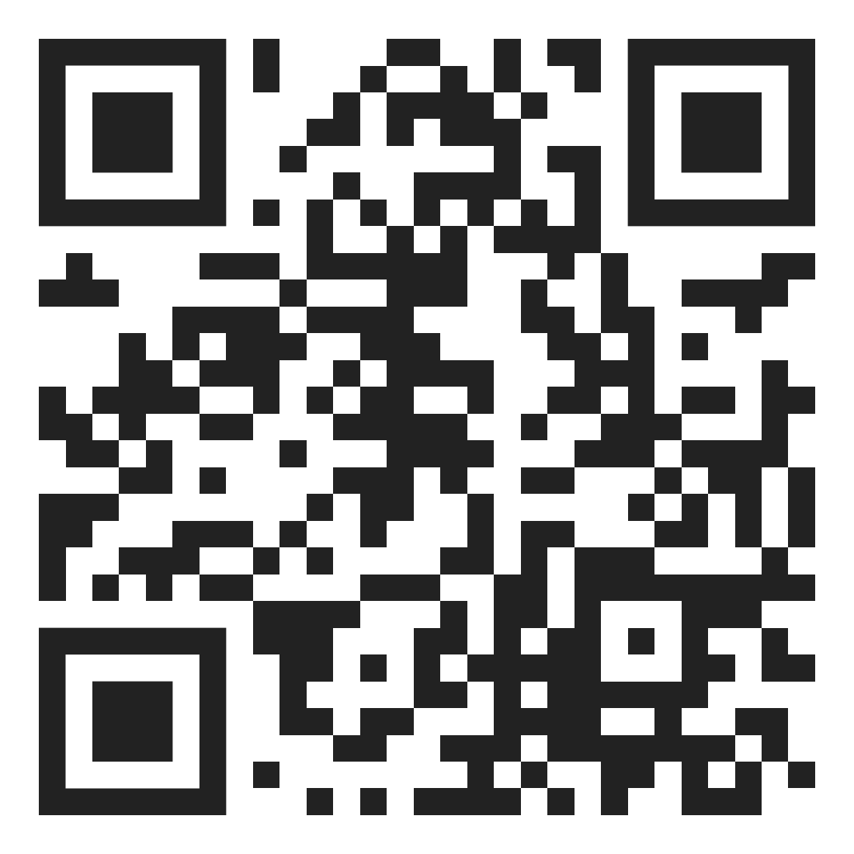
WE VALUE PARTNERSHIPS
Strongest Families Institute
Canadian Forces Member Assistance Program
Health Care
  NS Virtual Health Care
  Maple Virtual Health Care

Slide 19
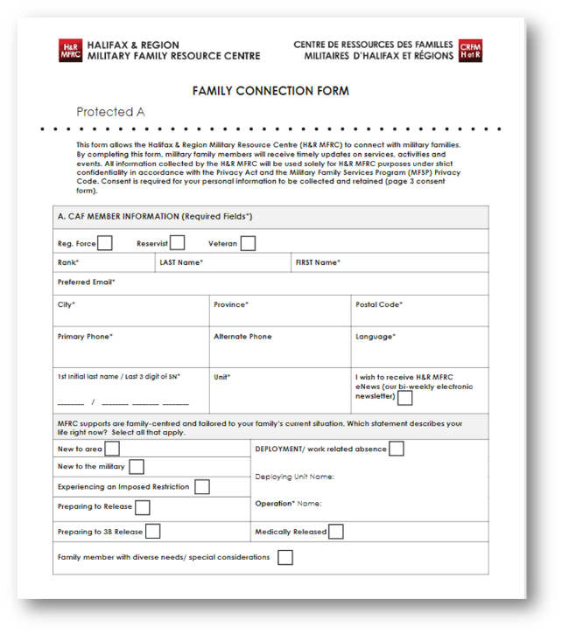
FAMILY
CONNECTION
FORM
IMPORTANT
!

Slide 20
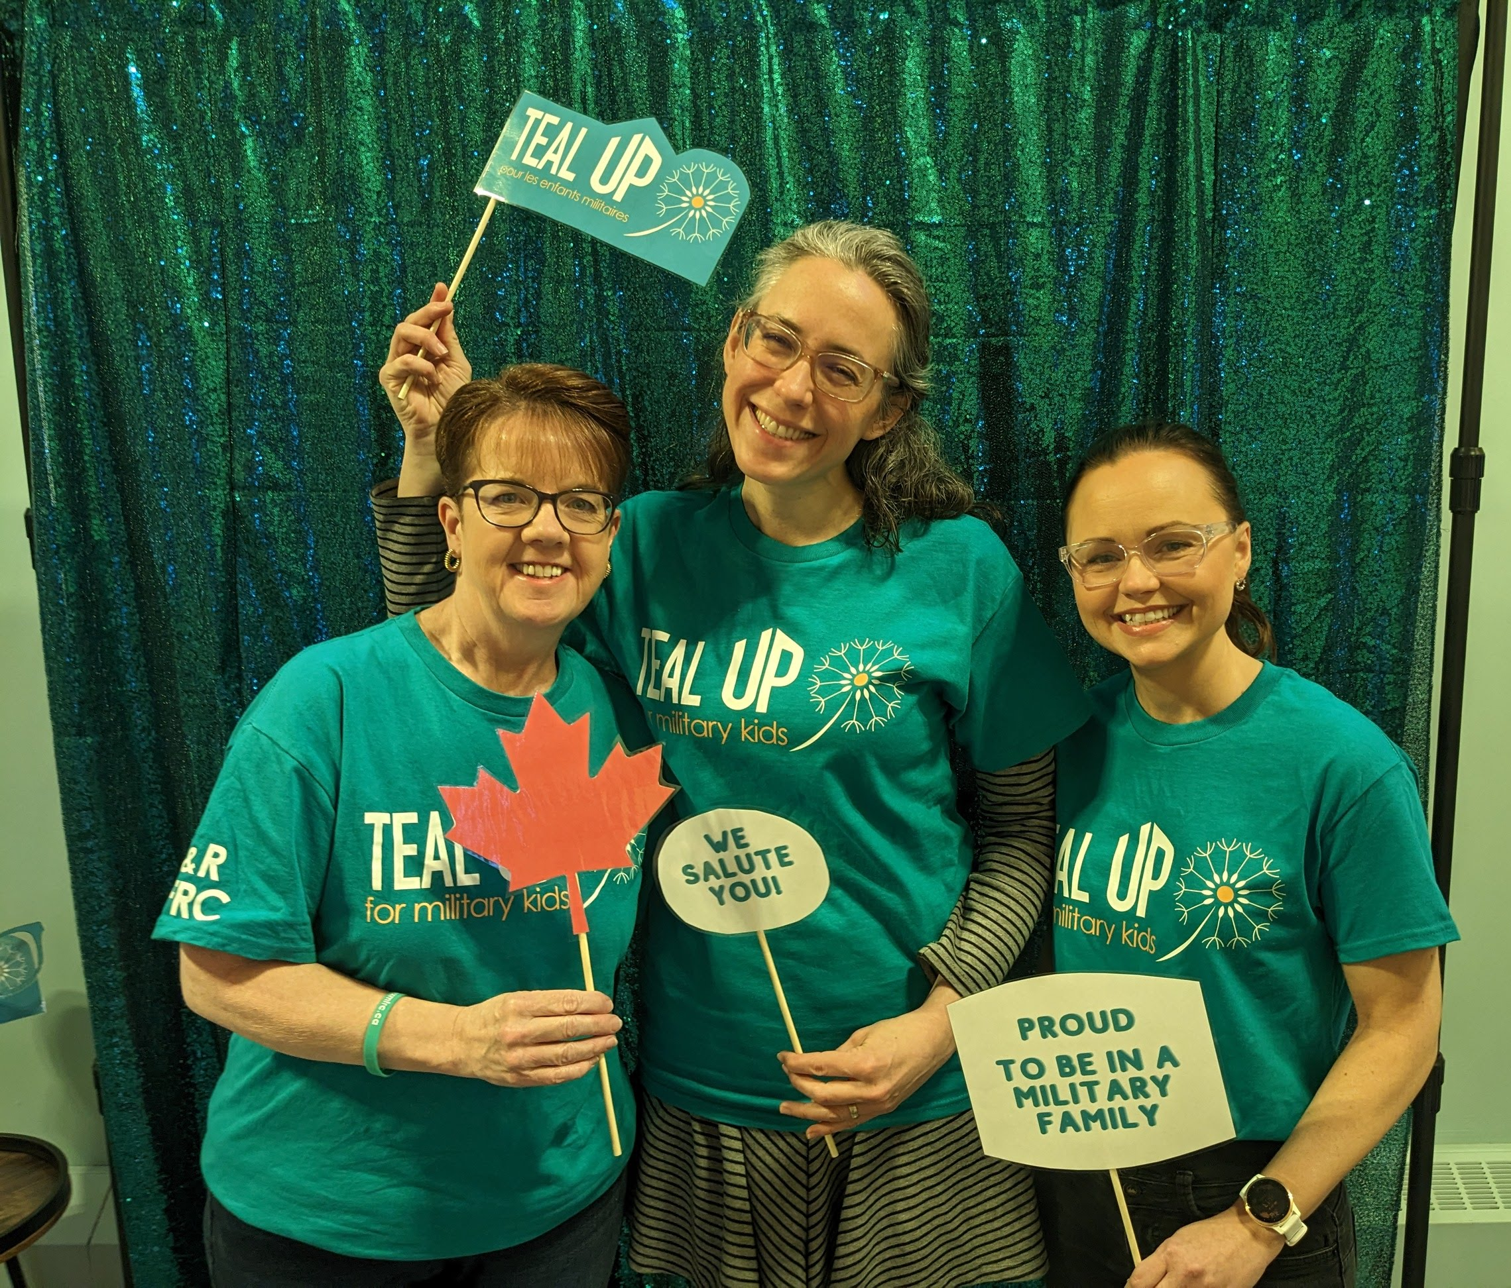
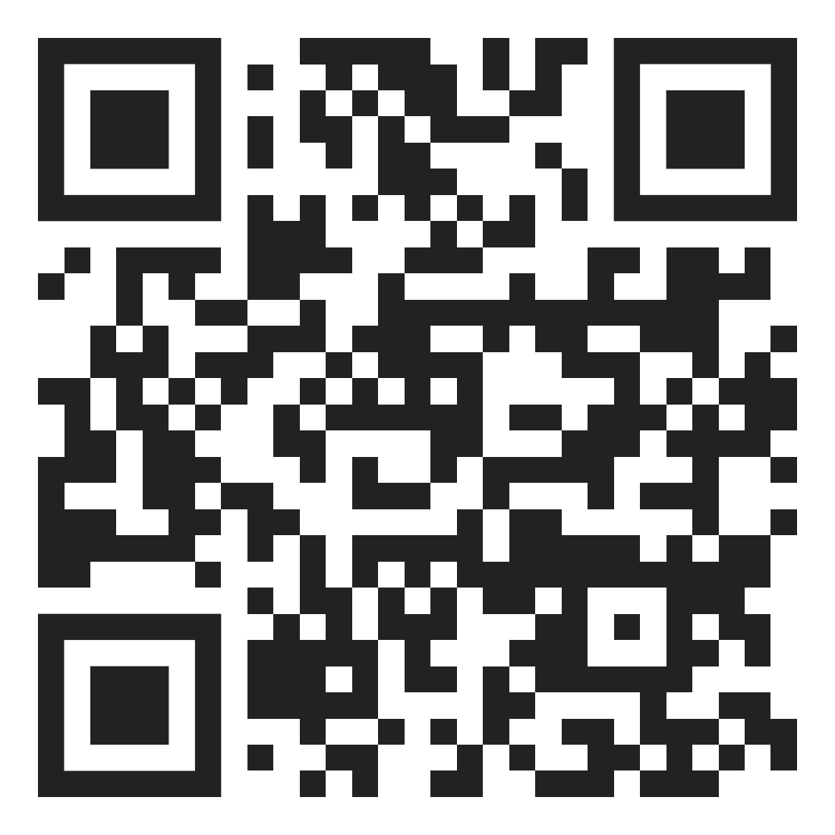
TEAL UP
April is the Month of the Military Child, established to recognize and thank children from military families.

Slide 21

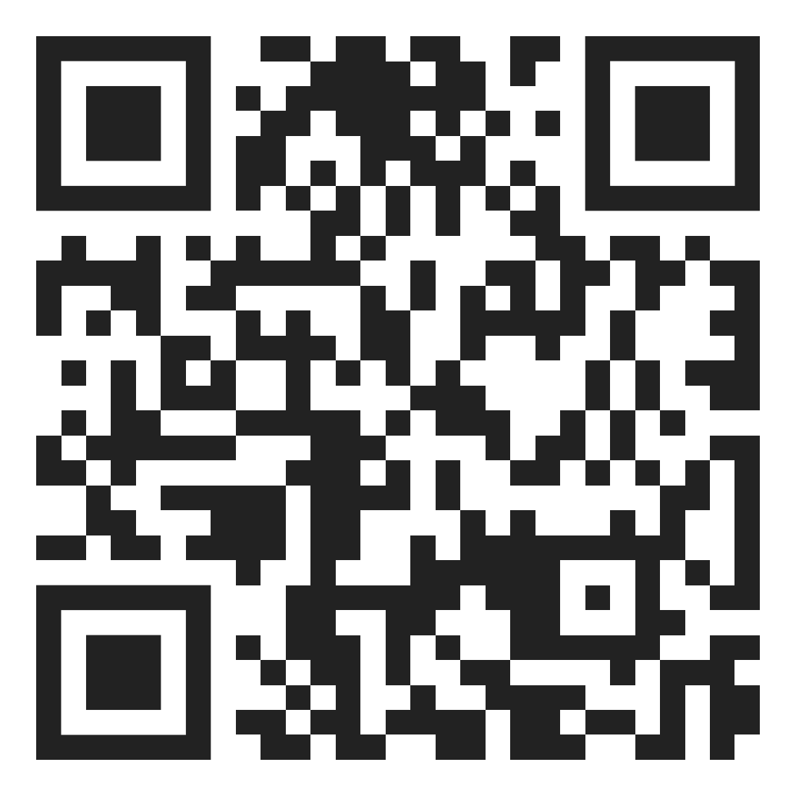
EDUCATOR SUPPORT
New course!
Educators Supporting Military-Connected Children!
School Outreach

Slide 22
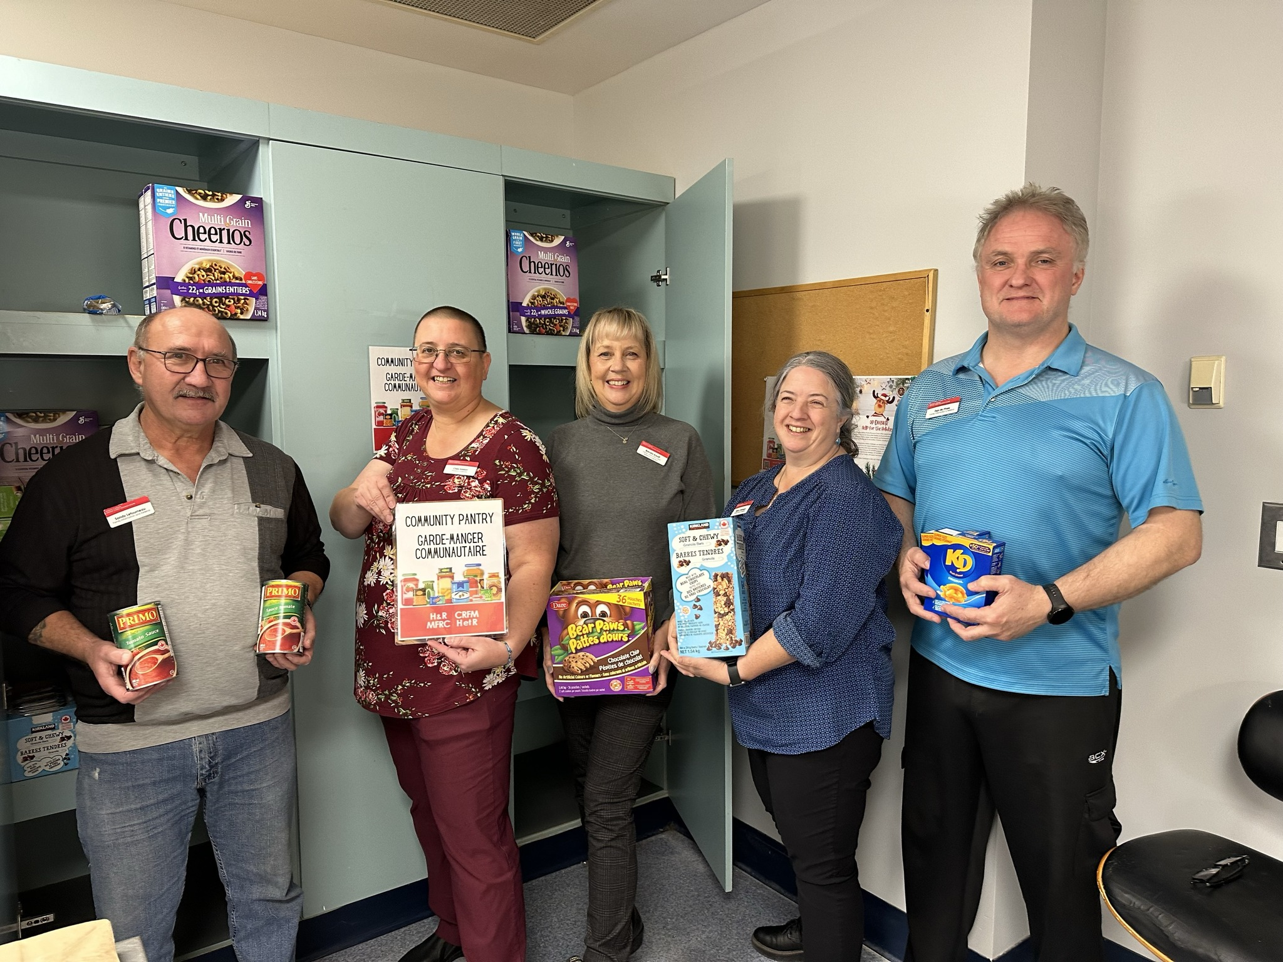
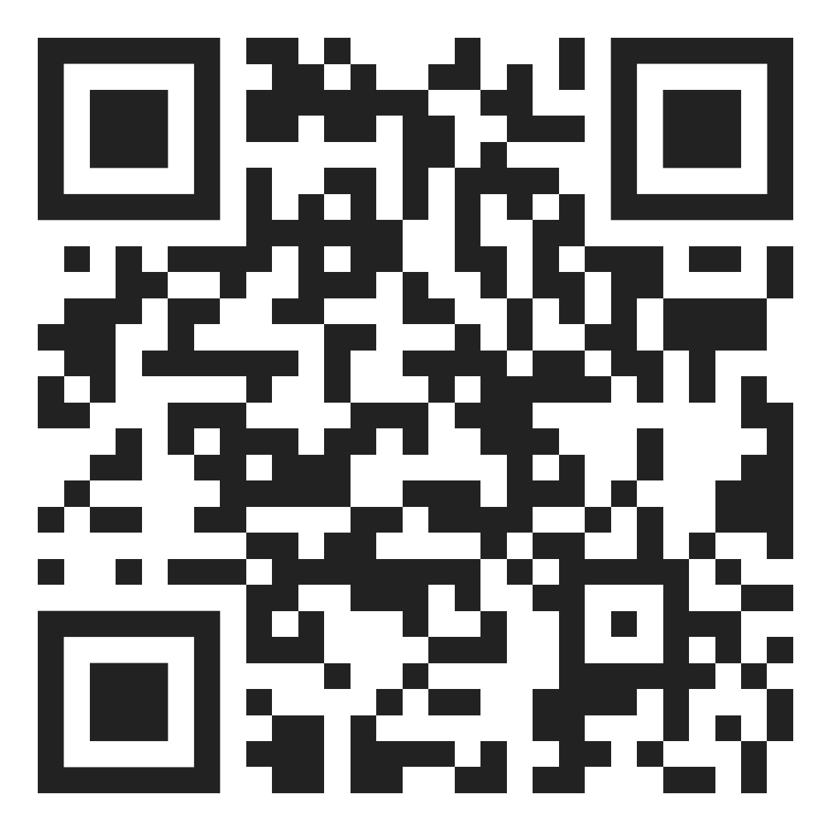
COMMUNITY PANTRY
All military and Veteran families can access the community pantry anonymously.

Slide 23
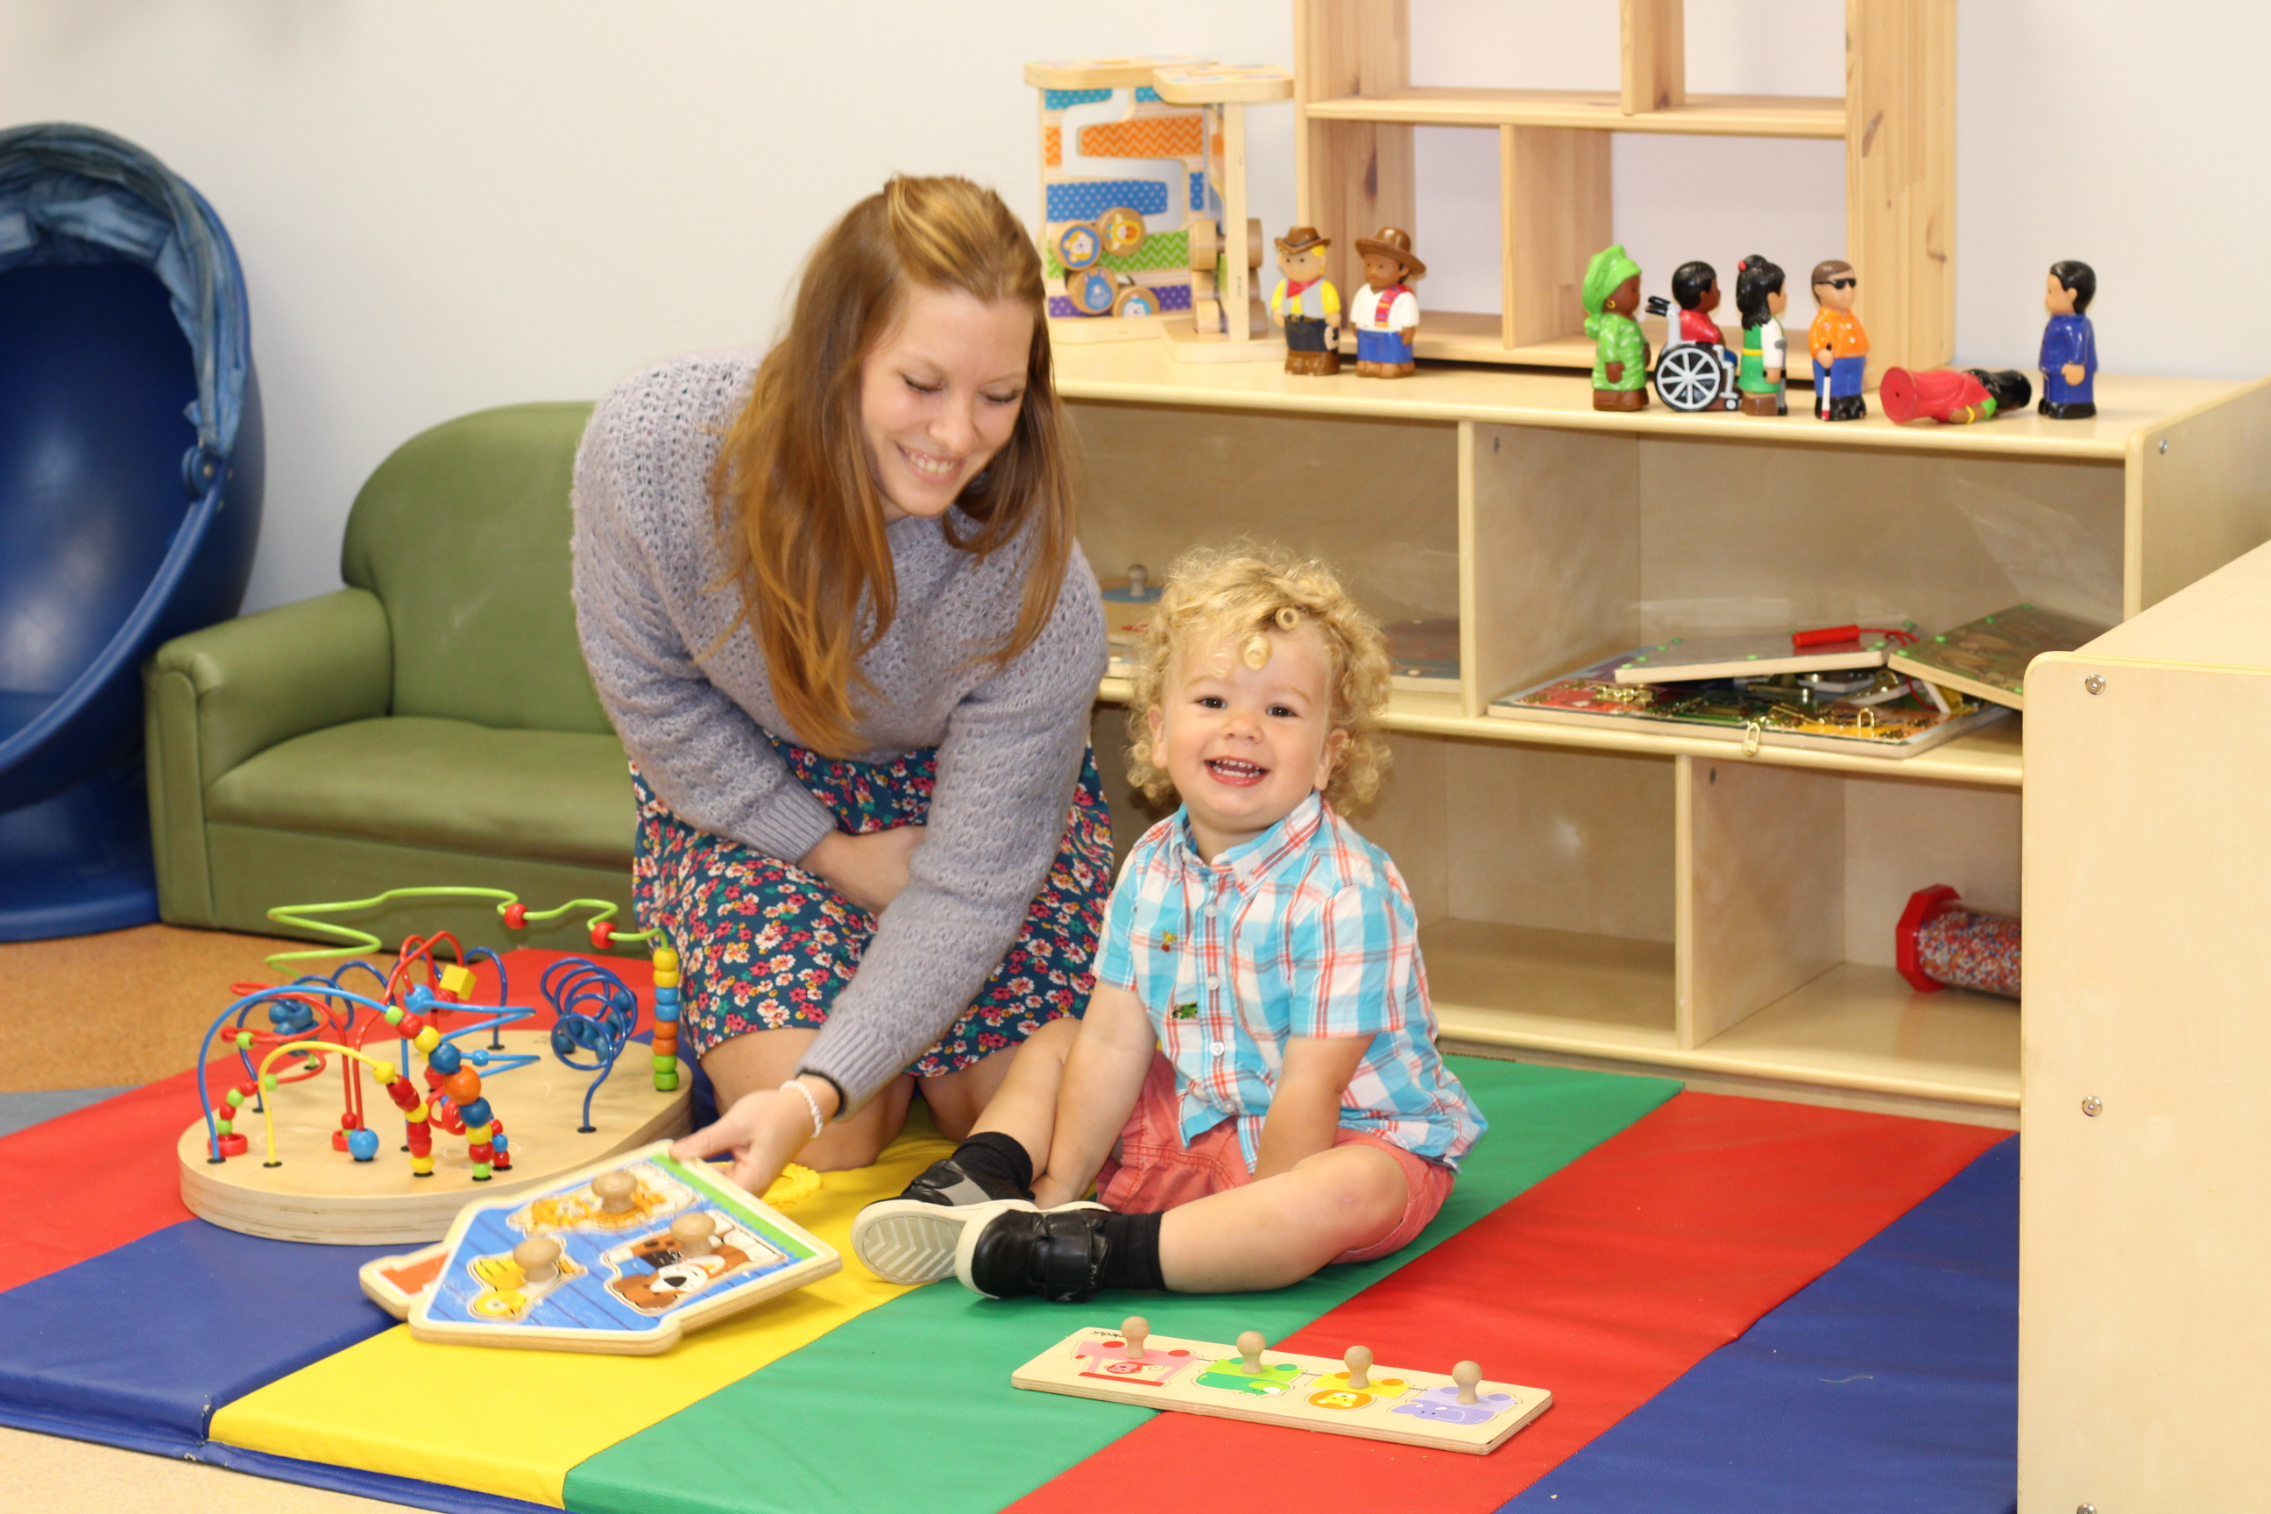
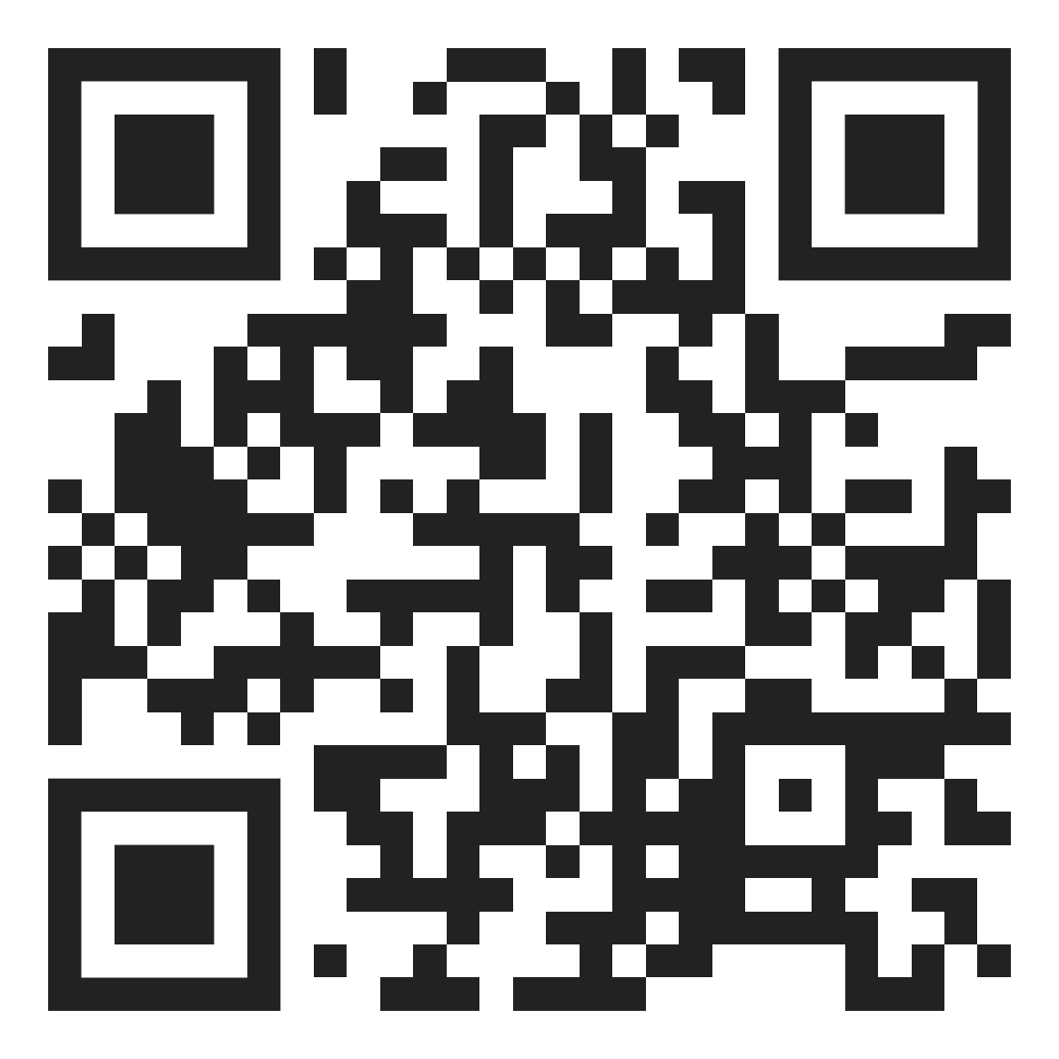
OCCASIONAL & RESPITE CHILD CARE
A flexible and inclusive short-term child care service in Halifax and Shearwater.

Slide 24
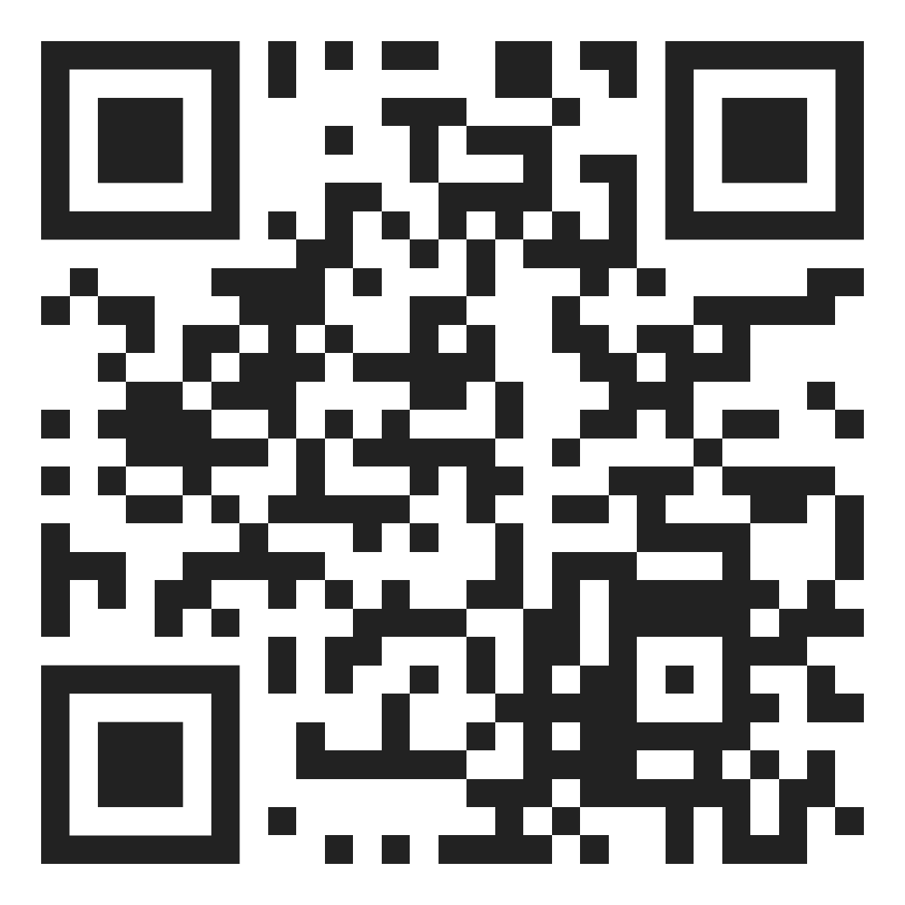


GET CONNECTED
halifaxmfrc.ca
info@hrmfrc.ca
902-427-7788
In-Person
@hrmfrc

