Slide 1

5 WAYS TO
OPTIMIZE YOUR PERFORMANCE IN TEXAS
OPTIMIZE YOUR PERFORMANCE IN TEXAS
Krystin Leptich-Therens Zoran Stojkovic James White
Notes:
[ZORAN]
Hey everyone, welcome — I’m Zoran, and joining me are Krystin and Jamie.
We’re here to help you get the most out of your deployment — mentally, physically, and operationally.
Grab a pen and paper if you can; ops will also send a copy of these slides to your Signal chat.
We’ll keep this short, simple, and practical — a few things you can actually use out there.

Slide 2

Disruption
New environment
Disrupted routines
Hotel living
Unfamiliar terrain & procedures
Limited social support
Notes:
[ZORAN]
Texas will be a new and different experience — both fun and challenging.
You’ll be living out of hotels, flying in new airspace, adjusting to a new rhythm.
That disruption can impact your stress levels, focus, and daily flow — unless you get intentional about how you handle it.
That’s what these five strategies are for — to help you perform and stay sharp even when things feel unfamiliar.

Slide 3
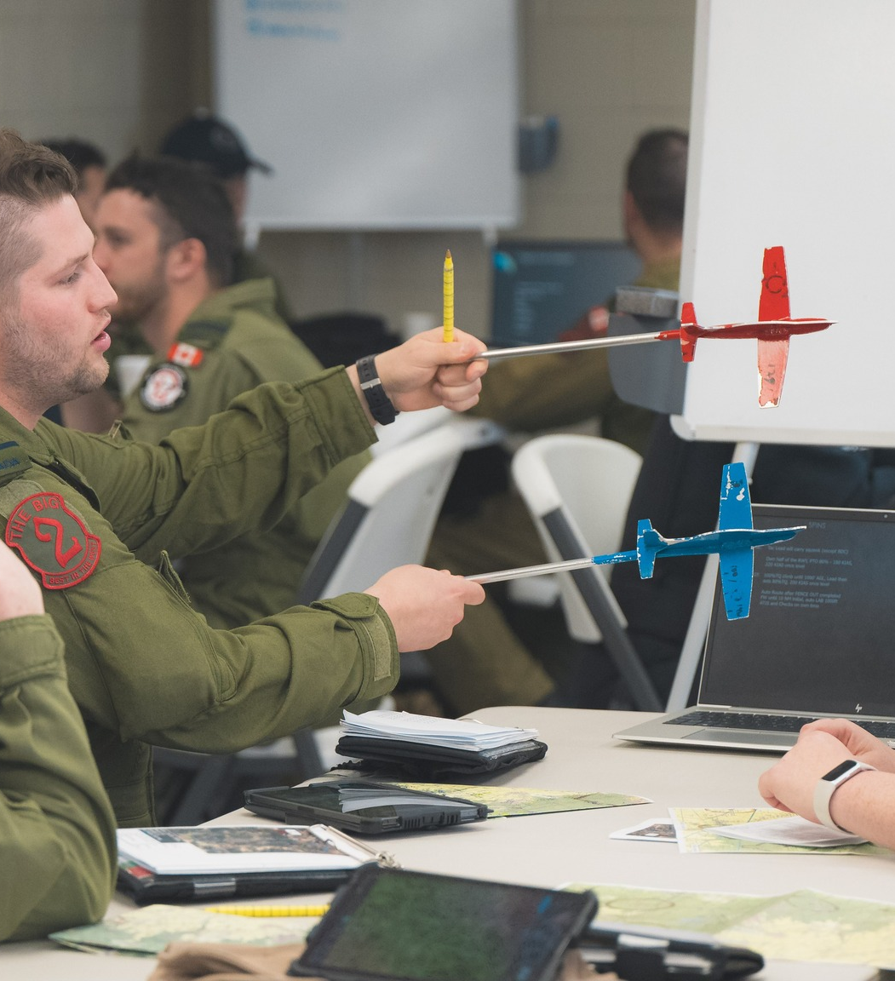
#1: Be Efficient
Block your day
Shape your space
Protect key routines
Notes:
[ZORAN]
When everything changes around you — structure becomes your anchor.
Break your day into small, predictable blocks: flight prep, meals, workouts, downtime.
Shape your hotel room into a mini operating base — keep essentials visible, distractions minimal.
Stick to the routines that work for you — whether that’s your pre-flight rituals or evening wind-down.
Habits are what make you adaptable — not just discipline.

Slide 4

#2: Mind your Mindset
3Ms: Mindfulness – Movement – Mindset
Sunlight & recovery
Reflective questions
Notes:
[ZORAN]
Start your day with the 3Ms — mindfulness, movement, and mindset.
Even a short routine — five minutes of breathing, a walk, and a quick intention for the day — can reframe everything.
A great way to work on your mindset is to start or end the day with journaling. The simple way to check in with yourself, process emotions, and stay grounded. Whether you're working through a challenge or tracking your goals, writing things down can help clear your mind and boost your focus. Journal prompts you can try:
What’s been on your mind lately, and how do you feel about it?
What’s one win you had today — big or small?
What’s something you’re looking forward to?
List out five things for which you’re grateful.
Write about a time when you overcame a hard emotion or experience — it doesn’t have to be sadness. How did you get through it?
These are going to be in the grit kit as well.
Sunlight exposure early in the day helps regulate your body clock and mood.
Finally, keep an eye on your inner dialogue and activation levels. Two questions to get yourself to reflect:
What’s your self-talk like under pressure?
What’s your activation level at right now, 1-10 with 10 being high activation? Is that the level you need at that moment? If now, what can you do to dial it back or amp it up?
You can’t always control your environment, but you can control your mindset going into it.
Efficiency and mindset set the foundation — next, Jamie will walk you through how to keep your body primed and performing at its best

Slide 5
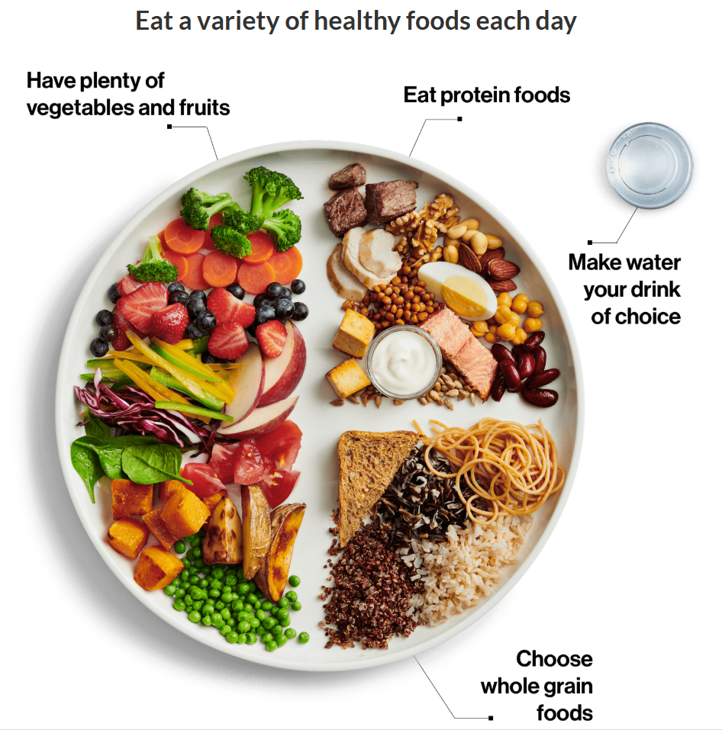
Canada's Food Guide Plate
#3: Fuel Your Engine
Its hard to be perfect, focus on balanced nutrition. Consider meal delivery services such as Factor or Front Porch Pantry.
Carbs aren't the enemy; they are the primary fuel source for your body. Consider the time and type of carbs.
Protein + fiber curbs hunger better than quick carbs

Slide 6
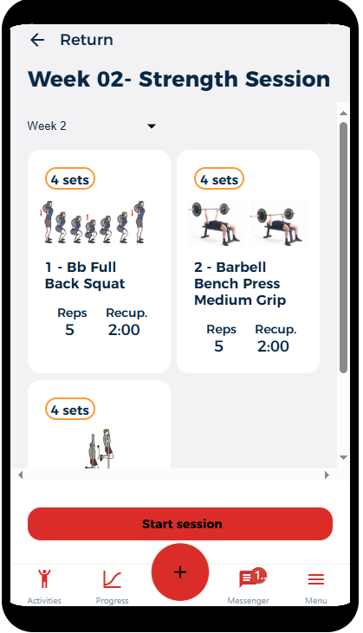
#4: Move your Body
Make movement a priority! 150 minutes per week = 30 minutes per day
Hexfit programming is available to help you maintain a gym routine. Workouts can be tailored to meet your individual needs while in Texas
Additional resources are available in the GRIT Kit for neck loading and total body stretching

Slide 7
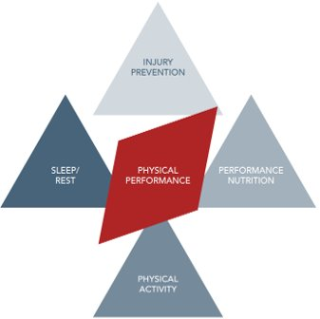
#5: Recover Intelligently
Practice good sleep hygiene – sleep routine, proper environment
S – Surface -
L - Light
A – Air Quality
N - Noise
T - Temperature
Intentionally add micro breaks to your day.
Add a decompression break at the end of your day
Notes:
Sleep
Sleep is non-negotiable if you’re trying to maintain a high level of physical and cognitive performance.
What research shows us is that even when compensating with stimulants like caffeine, reaction time to a visual stimulus is diminished when people are under slept; and we see this drop after even one bad night’s sleep.
The opposite is also true, even though alcohol is a depressant, and might make you feel more relaxed to wind down at the end of the night, it fragments our sleep cycles and doesn’t allow us to get a restful night’s sleep. Watch your alcohol and caffeine consumption. Focus on building or maintaining good habits to create alertness and rest.
To recover intelligently create for yourself the optimal environment for sleep.
Get into a sleep routine
Create the right environment
S- Surface - firm yet comfortable surface
L- Light (dark as possible – sleep mask, black out windows, avoid bright light and blue light (cell phone/ tablet) 1 hour before bed
A – air quality (disrupting smells)
N – Noise – reduce (ear plugs)
T – Temperature – 16-20 degrees C
Micro-Breaks
A micro break is defined as stepping away from the task you are working on for 5 minutes or less.
Intentionally creating these breaks in your workflow can help you to stay on task during your work period by training you to know that a break is coming.
Adults have an ideal focus capacity of 25-50 minutes and then mental strain sets in.
Studies have shown that taking a break before that strain starts taxing our cognitive resources can help to maintain capacity, accuracy, and memory retention.
Every 25-50 minutes plan to get up and move, doodle something creative, look out the window and appreciate your surroundings.
Try not to take a break by looking at your phone but by re-engaging with the rest of your body.
REMEMBER: You can’t pour from an empty cup so plan a longer break at the end of the day to focus on something you truly enjoy, that fills your cups so you are ready for the next day.

Slide 8
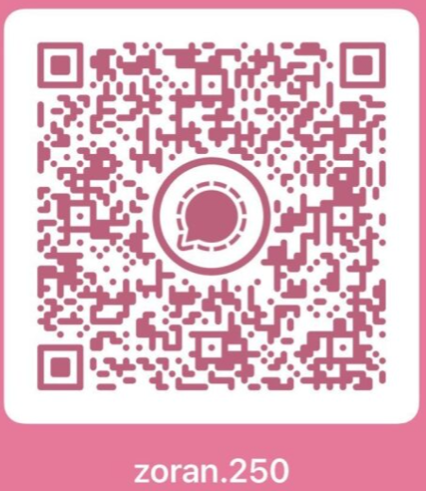
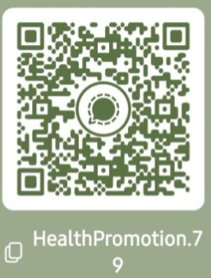
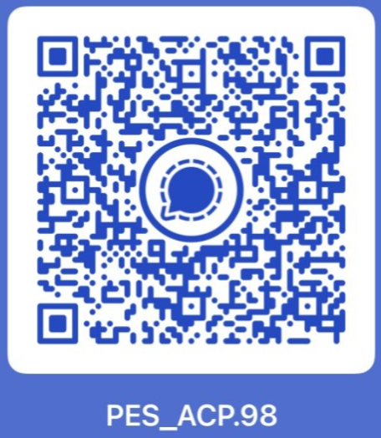
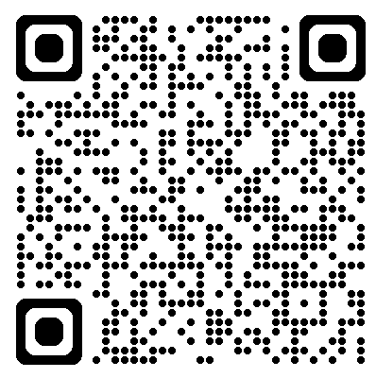
Remote Support
The Grit Kit
Online resources from all fields to help with performance, recovery, and quality of life.
Mental Performance
Health Promotion
Reconditioning
Pre-Flight Activation & Post Flight Recovery Strategies
Working Through Performance Challenges
Mindfulness & Stress Reduction
Habit Formation & Adapting to the New Environment
Sleep &Nutrition
Injury Prevention
Addiction Awareness and Prevention
Social Wellness – Connection, communication, culture, mental fitness/ suicide awareness.
Physical Training
Injury Rehabilitation
Individualized programming
Mobility/Flexibility
Pre/Post flight warmups and cool downs
Make sure you set your community to Moose Jaw at CFMWS.ca before scanning the QR Code.
Notes:
Connect with any of us through Signal or email.
The Grit Kit is meant to help you remain mentally fit, in a state of high performance, and create a balanced quality of life while in Texas.
The resources are organized by topics.
If something is missing, let us know and we can add to it rather quickly.
Taking time in your day to work through some of the activities in the Grit Kit can help to work on what we’ve talked about
Mental fitness, manage stress, workout plans, reminders on fueling your body, and recovery activities.

Slide 9
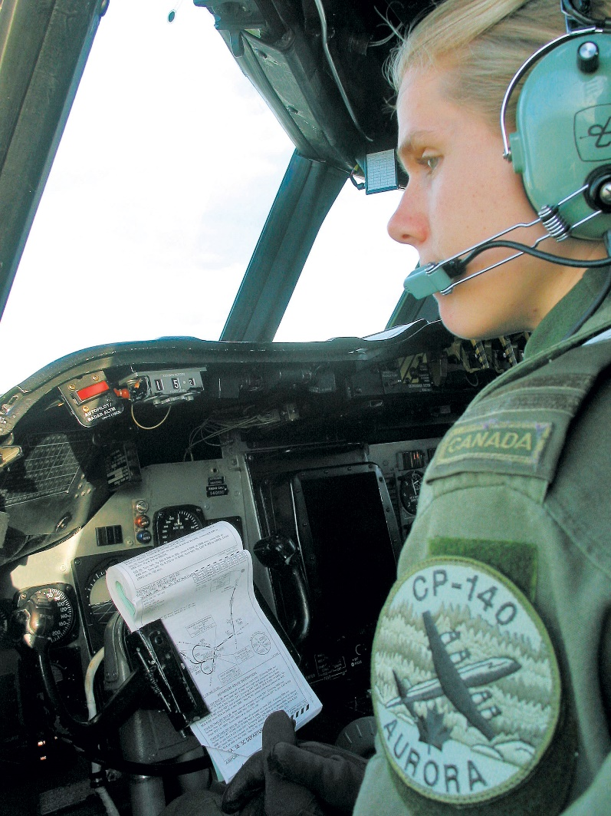
ReCAP
Be Efficient
Mind Your Mindset
Fuel Your Engine
Recover Intelligently
Move Your Body
Good Luck!
Notes:
Be efficient – Set up your daily workflow and hotel room for success
Mind your mindset – be aware of your inner world and use techniques to re-cage, re-calibrate and relax
Fuel your engine – be deliberate of anything you put into your body. It all compounds.
Recover intelligently – ensure you’re sleeping well, using pit stops during the day, and keeping an eye on your energy levels.
Move your body – be intentional with the frequency, intensity, and type of exercise you’re doing.
If you do even some of those habits on a daily basis, you’ll create the conditions for yourself to optimize your performance and wellbeing in Texas.

