Slide 1
Dress Policy – Chapter 2 Changes / June 2024
Background:
In November 2021, DHH provided a briefing to the AFC whereby Dress Instructions at that time were deemed to lack inclusivity and where view has:
Discriminatory;
Lag behind GC Employment Equity and constitutional rights; and
Don’t reflect modern society.
With the approval from the CDS and the support of the key stakeholders (AFC, NDCDC and DAGs), a major update to the standards for appearance came into effect in September 2022. The overall aim of these changes was to make the policy more inclusive, less prohibitive, and to allow CAF members increased freedom to make personal choices regarding their appearance while reflecting credit on the CAF and maintaining safety and operational effectiveness.
It was decided that these changes would need to be reviewed 12 to 18 months after they came into effect to ensure they reflect the following guiding principles: CAF members’ appearance and dress shall be safe, operationally effective, inclusive, and reflective of the profession of arms and tradition associated with service in the CAF, while maintaining our core values and ethics.

Slide 2
Dress Policy – Chapter 2 Changes / June 2024
THE ADJUSTMENTS TO CHAPTER 2, SECTION 2: APPEARANCE ARE:
BLUF:
1. HAIR WILL BE REQUIRED TO BE TIED BACK AWAY FROM THE FACE IF IT FALLS BELOW THE LOWER PART OF THE COLLAR AT THE NAPE OF THE NECK.
2. HAIR ACCESSORIES WILL BE BLACK, DARK BLUE OR SIMILAR TO THE MEMBERS HAIR COLOUR.
FACIAL HAIR IS RESTRICTED TO A MAXIMUM LENGTH/BULK OF 2.5 CENTIMETRES (1 INCH). Facial hair accessories are not authorized.
IMPLEMENTATION: 2 July 2024.

Slide 3
Dress Policy – Chapter 2 Changes / June 2024
SECTION 2- APPEARANCE
DEPORTMENT
1. Responsibilities. Pursuant to QR&O 17.02, the deportment and appearance of all ranks, in uniform or when wearing civilian attire, shall on all occasions reflect credit on the CAF and the individual. It is the responsibility and duty of all CAF members to ensure that, by their vigilance, actions and example, the policies, regulations and instructions contained herein are adhered to.
2. Conduct. Personnel in uniform shall comport themselves in a manner which projects a positive military appearance.
3. Military Presence. CAF personnel wearing military uniform and civilian clothes on military installations and in military groups or settings shall dress and comport themselves at all times as befits members of a professional, respectful, disciplined, cohesive force.
Key points (No Change)
Reflect credit on the CAF and the individual.
Responsibility of all CAF members.
Positive military appearance
Professional, respectful, disciplined, cohesive force.

Slide 4
Dress Policy – Chapter 2 Changes / June 2024
SECTION 2- APPEARANCE
HAIR
5. Hair shall not prevent the proper wear of a military headdress or protective equipment. Hair must be worn so that without headdress the member’s face is visible.
Full or partial shaving of hair on the head is permitted.
Members are authorized to colour their hair.
The wearing of wigs, locks, or hair extensions is permitted. Long hair is permitted. Regardless of the order of dress if the hair extends below the collar of the shirt, tunic, jacket, or outerwear, it must be tied back away from the face and off the collar. Acceptable accessories to tie hair are, clips, barrettes, bobby pins, and hair elastics. These accessories shall be black, or similar to the member’s hair colour. Bandanas and coloured bows are not authorized.
Regardless of the hair style, it shall be well groomed, neat, tidy and reflect a positive image. See below note.
Hair for ceremonial occasions, shall be worn as per para 14c of this section - SPECIFIC GUIDANCE FOR CEREMONIAL OCCASIONS WHILE WEARING DRESS ORDER #1
Key points (Changes)
Hair must be tied back away from the face and off the collar
Accessories to tie hair shall be black, or similar to the member’s hair colour

Slide 5
Dress Policy – Chapter 2 Changes / June 2024
SECTION 2- APPEARANCE
PRINCIPLES
4. While ceremonial standards may apply in certain circumstance, the CAF policy on appearance is premised on four principles: safety, operational effectiveness, inclusion, and a reflection of changing societal norms. These principles, listed in priority, are defined as:
Safety All members of the CAF are responsible to ensure that the safety of personnel is not compromised.
Operational effectiveness. At no time should clothing or personal appearance adversely affect the operational capability of a CAF member or their team.
Inclusion. The practice of providing equal access to opportunities and resources, where all members have a sense of belonging and are encouraged to be their authentic selves. Leaders are to treat with dignity and respect to all personnel under their care. In some cases, additional accommodations may be needed. Specific accommodations in respect of this policy are regulated under DAOD 5516-3.
Societal Norms. As a prime Canadian institution, the CAF is to be consistent with akin Canadian institutions of similar mandate while embracing culture evolution.
Key points
Safety (No change)
Operational effectiveness (No change)
Inclusion (No change)
Societal norm (Revised)

Slide 6
Dress Policy – Chapter 2 Changes / June 2024
SECTION 2- APPEARANCE
HAIR
6. Facial Hair.
a. All styles of facial hair and sideburns are authorized. It must be symmetrical to a maximum length/bulk of 2.5 centimeters (1 inch).
c. Commanders of commands, task force commanders and commanding officers retain the right to order restrictions on the wearing of a facial hair and sideburns to meet national regulations such as DAOD 5021-1, Respiratory Protection - Canada.ca or other operational requirements.
Key points (Changes)
Facial hair is restricted to a maximum length/bulk of 2.5 centimeters (1 inch)
Accessories to facial hair is not authorised

Slide 7
Dress Policy – Chapter 2 Changes / June 2024
SECTION 2- APPEARANCE
HAIR
7. In cases where Safety and/or Operational effectiveness may be compromised, or where a hairstyle is associated with a cultural, religious or spiritual belief that does not align with this policy, members are to refer to DAOD 5516-3 and section 3 of this chapter.
Note: The following definitions shall be used:
Grooming; is defined as “the act of giving it a neat and tidy appearance.”
Neat; is defined as “set in an orderly condition.”
c. Tidy; is defined as “methodically arranged and controlled, not messy.”
Key points (Clarification)
Grooming, Neat, and Tidy are clarified

Slide 8
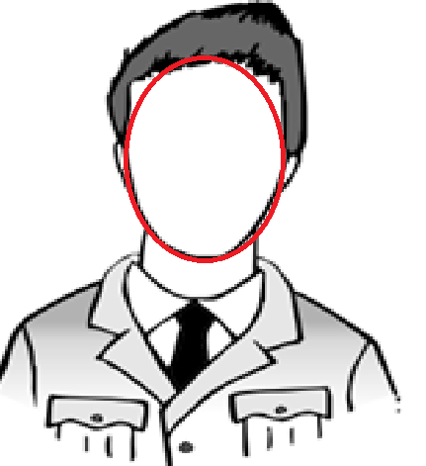
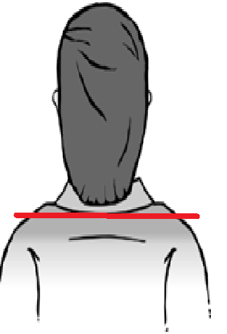
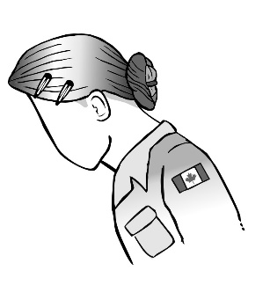
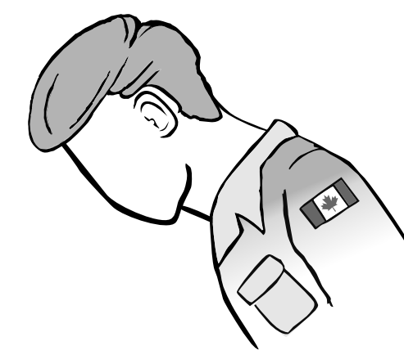
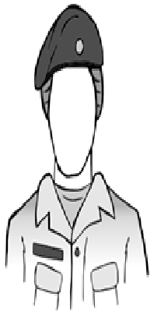
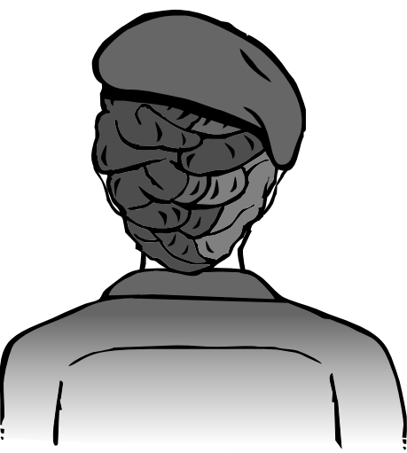
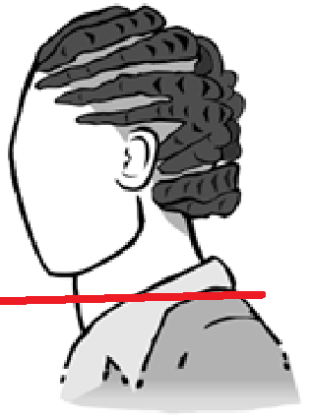
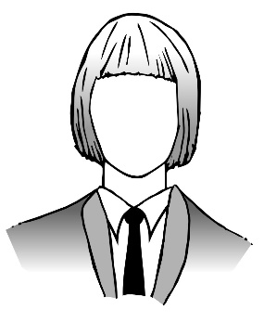
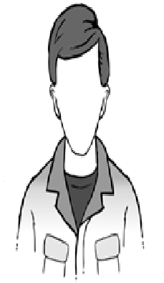
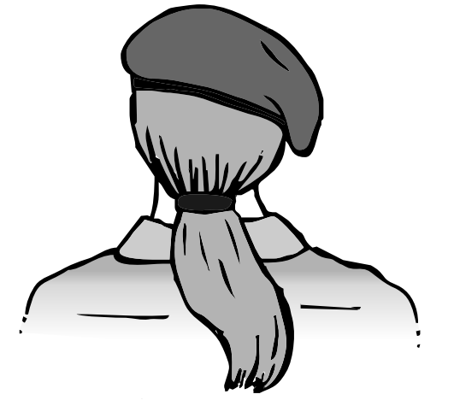
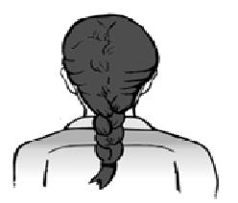
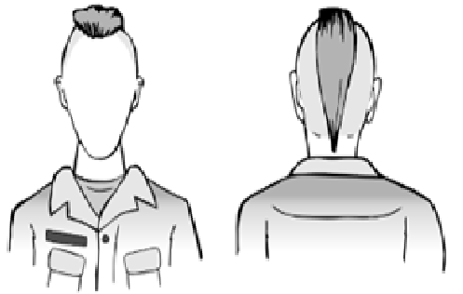
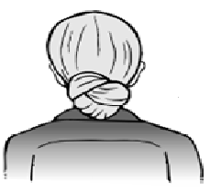
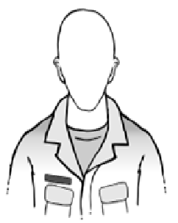
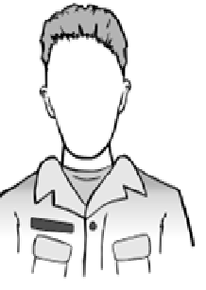
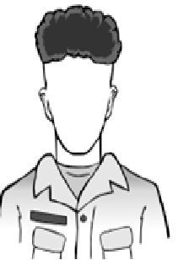
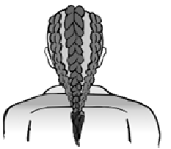
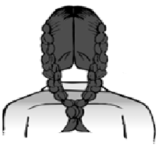
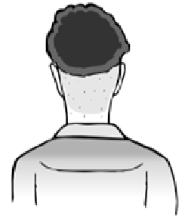
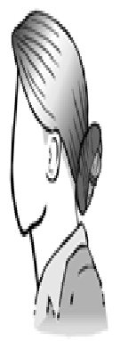
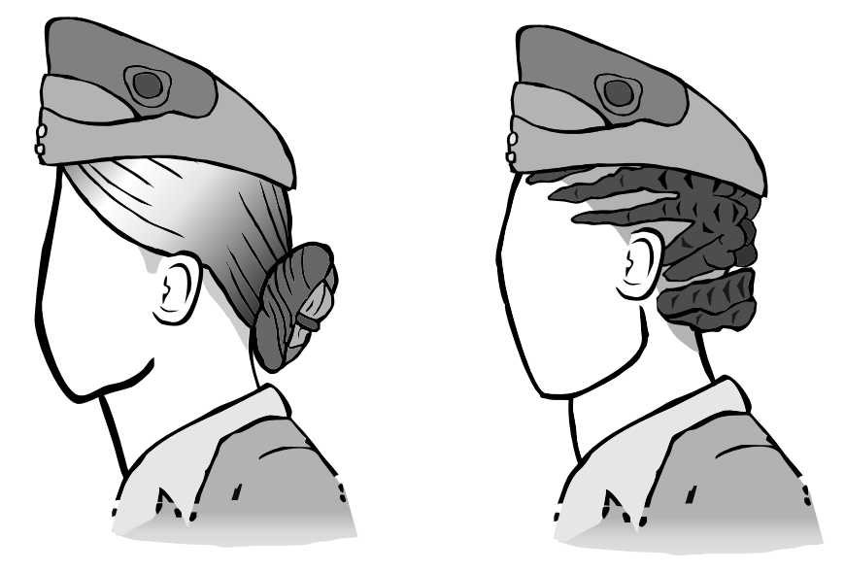
Dress Policy – Chapter 2 Changes / June 2024
Hair Dos
Hair shall not cover the face
Hair that extents below the back of the collar shall be secured to the back
Hair shall not fall in the face when leaning forward
Hair shall not prevent the proper wearing of head dress
Regardless of the hair style, it shall be well groomed, neat, tidy and reflect a positive image on the CAF

Slide 9
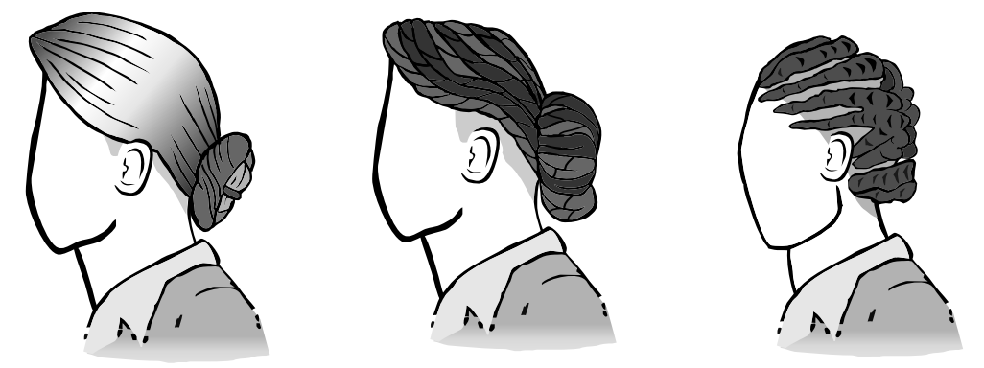
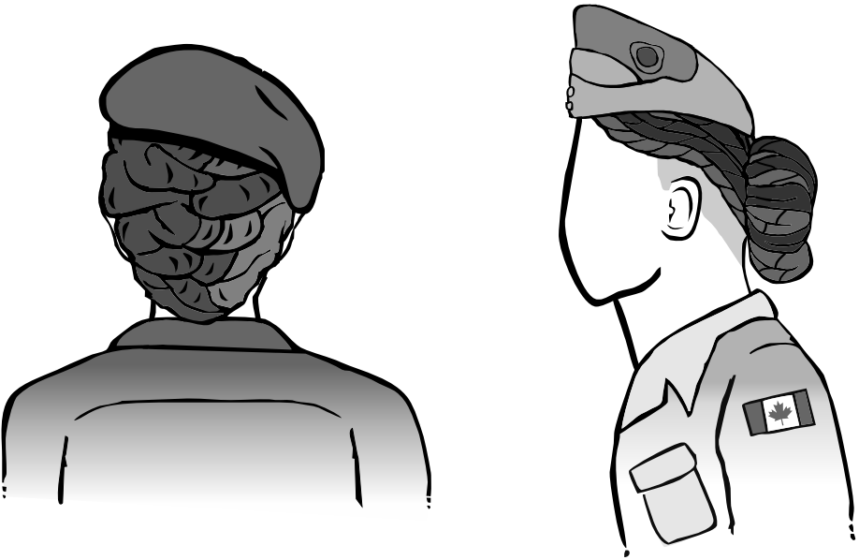
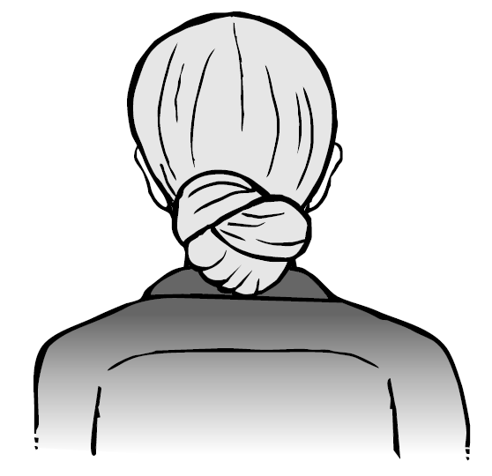
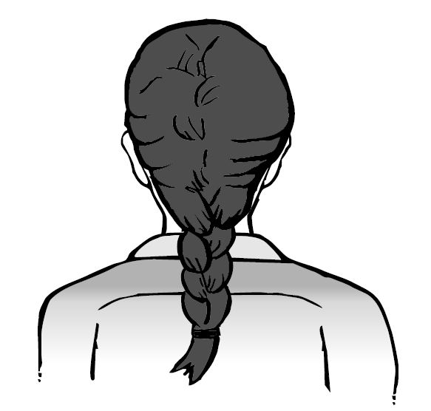
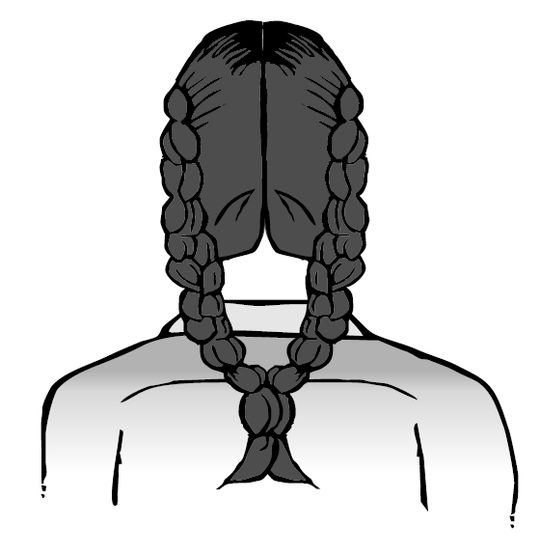
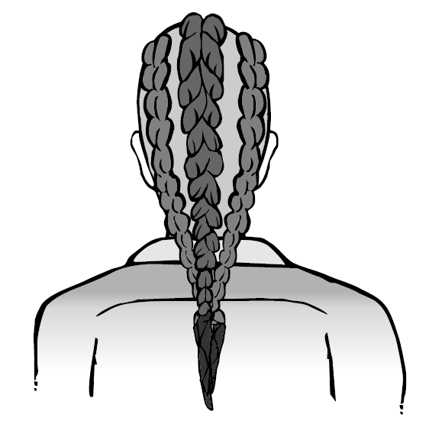
Dress Policy – Chapter 2 Changes/ DRAFT May 2024
Ceremony (No change)
Hair that extends below the service dress jacket collar shall be secured in one of the following styles:
In a bun; or
A single braid; or
Double braids centred to the back; or
Multi braids, or locks, be pulled back to the centre of the back or equally positioned along the shoulder blades and secured; or
When hairstyle, or hair type, does not allow a member to adopt one of the aforementioned hairstyles, member must discuss with the Chain of Command to find a hairstyle that can be secured accordingly.

Slide 10
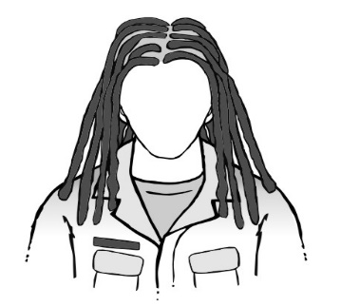
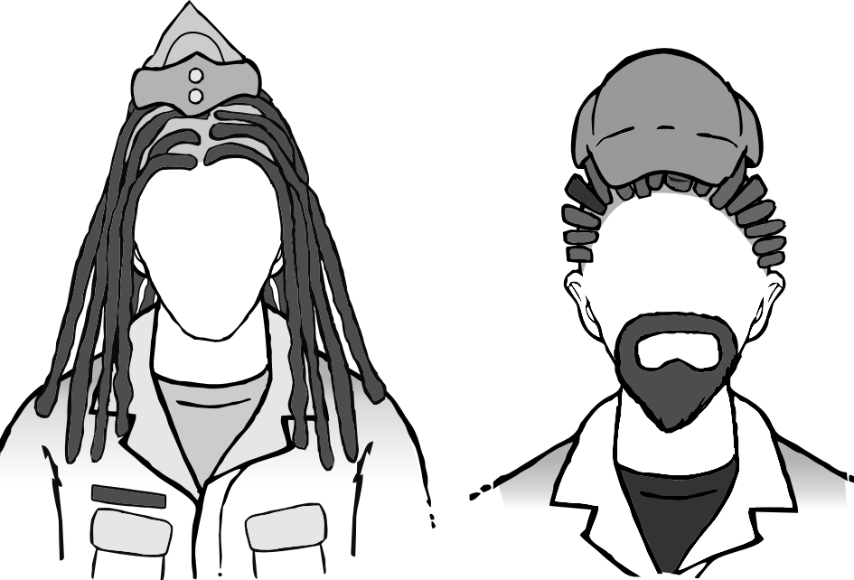
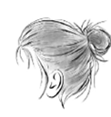
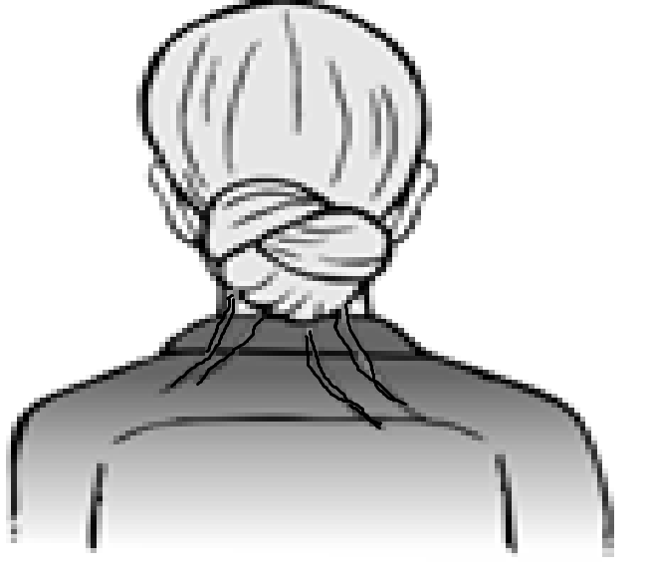
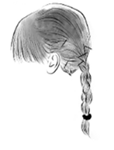
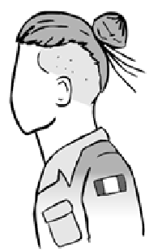
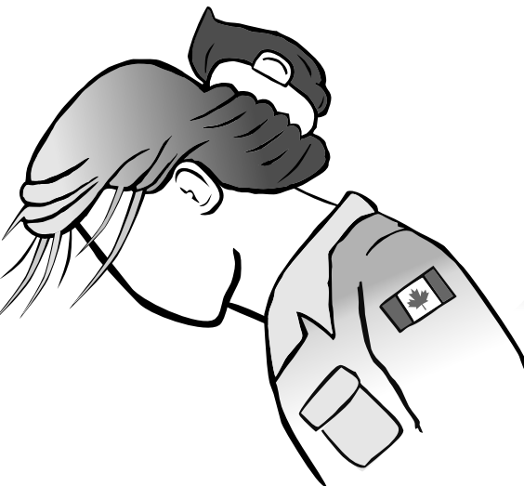
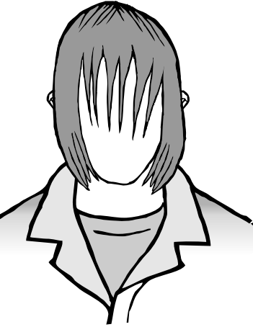
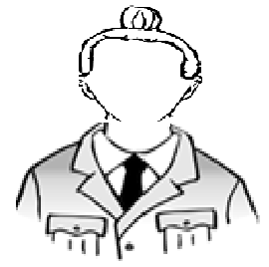
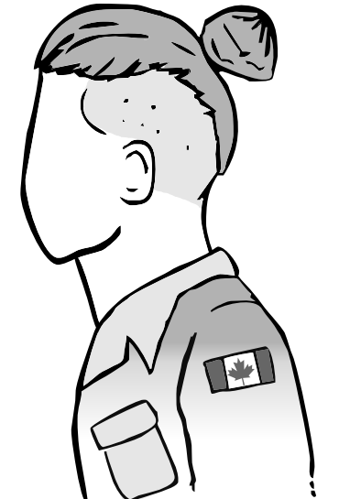
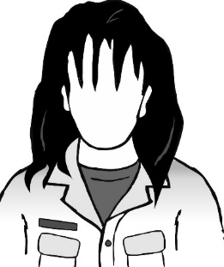
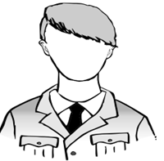
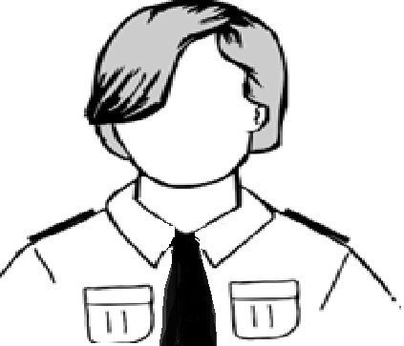
Dress Policy – Chapter 2 Changes/ DRAFT May 2024
Hair Don’ts
Hair shall be neat and tidy
- no messy buns
- no loose strands
- no pins sticking out
- no large hair clips
- bangs cannot cover or fall in the face
Hair shall be tied back if it falls below the collar at the nape of the neck
Hair shall not prevent the proper wear of headdress

Slide 11
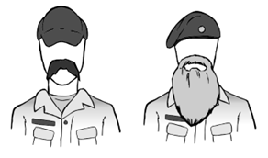
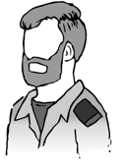
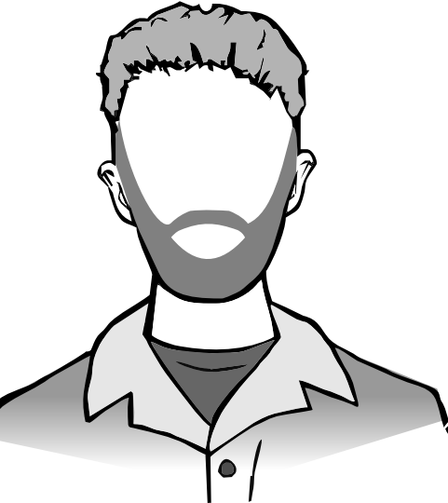
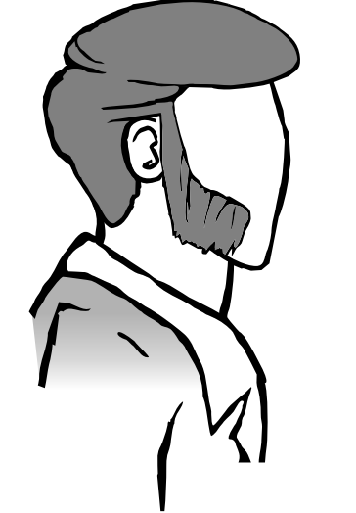
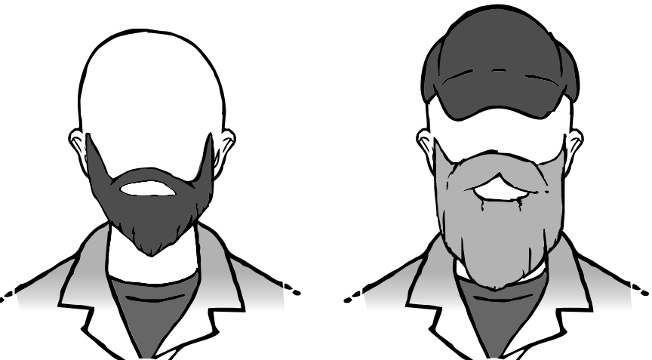
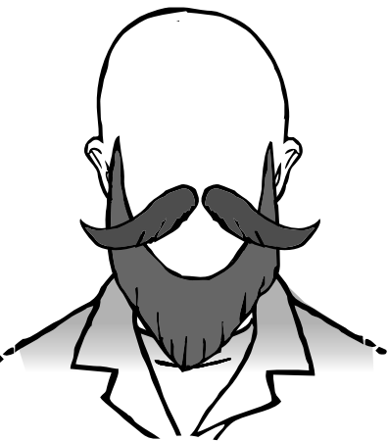
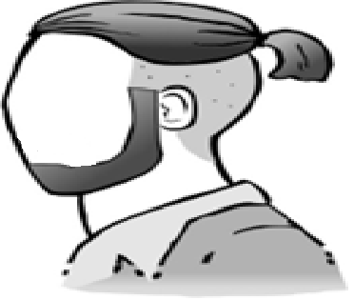
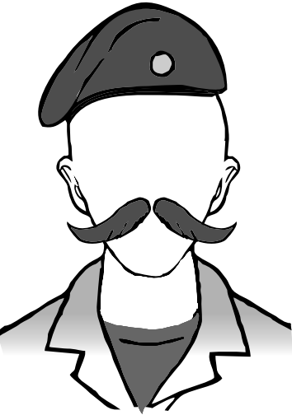
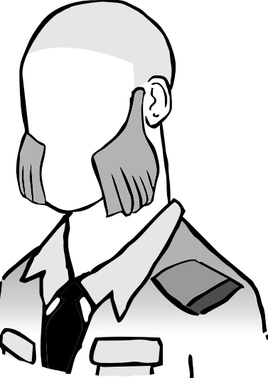
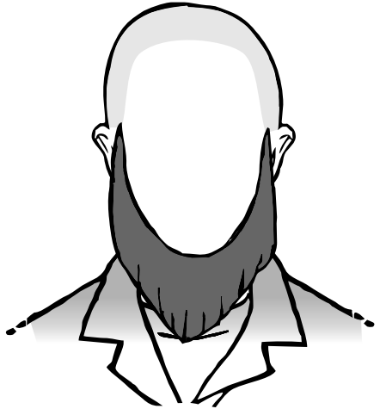
Dress Policy – Chapter 2 Changes/ DRAFT May 2024
Facial Hair Dos
Facial Hair Don’ts
All styles of facial hair and sideburns are authorized
Facial hair must be trimmed in clean lines, kept neatly groomed and symmetrical to a maximum length / bulk of 2.5 cm (1 inch). Mustache, including handlebar mustache are not authorized to exceed 2.5 cm/ 1 inch long.
Examples of facial hair exceeding 2.5 cm (1 inch) in length.

Slide 12
Dress Policy – Chapter 2 Changes/ DRAFT May 2024
Authorized Accessories
Unauthorized Accessories

Slide 13
Questions? Discussion

