Slide 1






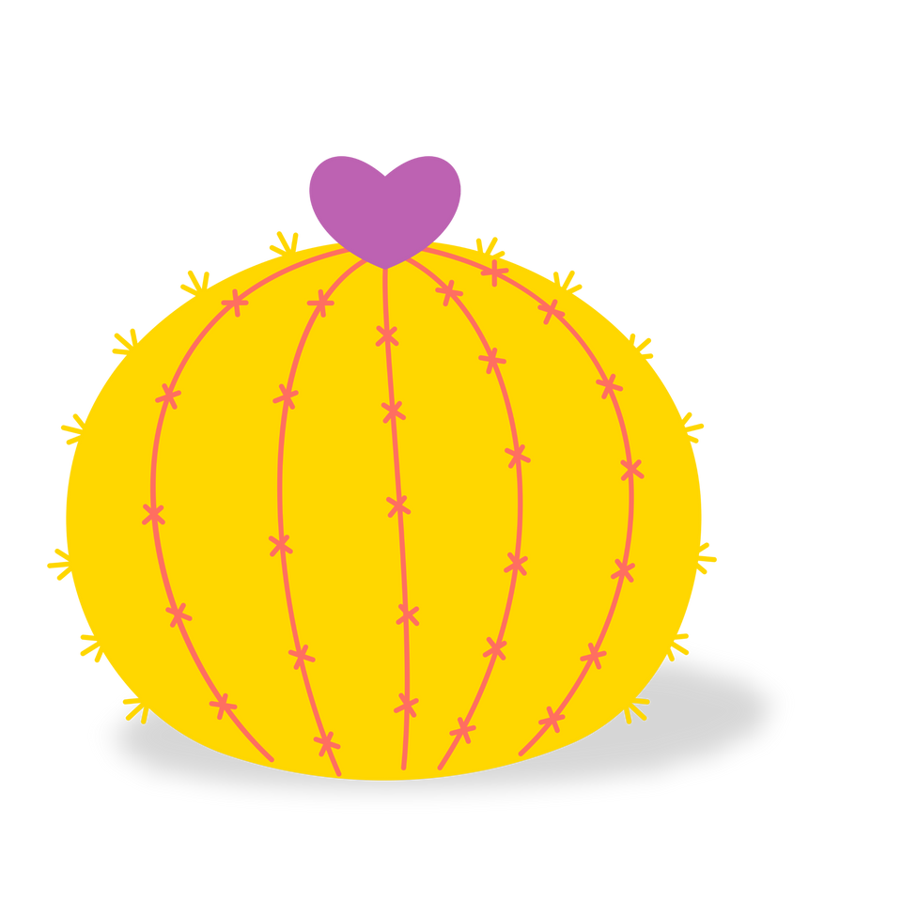
TEAL UP
FOR STRONG MILITARY KIDS
POUR LES FORTS ENFANTS DE MILITAIRES
CACTUS FRIENDS
FLOWER FRIENDS
VS

Slide 2
WHAT IS A
FLOWER FRIEND?
TEAL UP
FOR STRONG MILITARY KIDS
POUR LES FORTS ENFANTS DE MILITAIRES
Juniper and Danny are
Flower Friends
They are nice like a flower.
They care about you.
If they make a mistake they apologize and mean it.
They may joke around with you but stop when asked.
They don't say mean things about you to other people.
They are true friends.

Slide 3
WHAT IS A
CACTUS FRIEND?
TEAL UP
FOR STRONG MILITARY KIDS
POUR LES FORTS ENFANTS DE MILITAIRES
Thomas and Chloe are
Cactus Friends
They are prickly like a cactus.
They may say hurtful things to or about you.
They may apologize to you but do not mean it.
They may say mean things about you to other people.
They can make us feel sad.
They are not true friends.

Slide 4


TEAL UP
FOR STRONG MILITARY KIDS
POUR LES FORTS ENFANTS DE MILITAIRES
ACTIVITY TIME
ARE YOU READY?

Slide 5
YOU TRIPPED AND FELL.
BOBBY ASKED IF YOU ARE OKAY.
WHAT TYPE OF FRIEND IS BOBBY?
TEAL UP
FOR STRONG MILITARY KIDS
POUR LES FORTS ENFANTS DE MILITAIRES

Slide 6
CACTUS FRIEND
FLOWER FRIEND
TEAL UP
FOR STRONG MILITARY KIDS
POUR LES FORTS ENFANTS DE MILITAIRES
OR

Slide 7
FLOWER FRIEND!
TEAL UP
FOR STRONG MILITARY KIDS
POUR LES FORTS ENFANTS DE MILITAIRES

Slide 8

TEAL UP
FOR STRONG MILITARY KIDS
POUR LES FORTS ENFANTS DE MILITAIRES
SARAH IS CALLING YOU NAMES.
WHAT TYPE OF FRIEND IS SARAH?

Slide 9


CACTUS FRIEND
FLOWER FRIEND
TEAL UP
FOR STRONG MILITARY KIDS
POUR LES FORTS ENFANTS DE MILITAIRES
OR

Slide 10
CACTUS FRIEND!
TEAL UP
FOR STRONG MILITARY KIDS
POUR LES FORTS ENFANTS DE MILITAIRES

Slide 11
TEAL UP
FOR STRONG MILITARY KIDS
POUR LES FORTS ENFANTS DE MILITAIRES
AMRITA CALLED YOU SILLY.
YOU ASKED HER TO STOP AND SHE APOLOGIZED. AMRITA DIDN'T CALL YOU SILLY AGAIN.
WHAT TYPE OF FRIEND IS AMRITA?

Slide 12

CACTUS FRIEND
FLOWER FRIEND
TEAL UP
FOR STRONG MILITARY KIDS
POUR LES FORTS ENFANTS DE MILITAIRES
OR

Slide 13

FLOWER FRIEND!
TEAL UP
FOR STRONG MILITARY KIDS
POUR LES FORTS ENFANTS DE MILITAIRES

Slide 14
TEAL UP
FOR STRONG MILITARY KIDS
POUR LES FORTS ENFANTS DE MILITAIRES
YOUR MOM LEFT TO GO ON A COURSE AT WORK.
ALEX SAW YOU CRYING AND ASKED IF YOU WERE OK.
WHAT TYPE OF FRIEND IS ALEX?

Slide 15
CACTUS FRIEND
FLOWER FRIEND
TEAL UP
FOR STRONG MILITARY KIDS
POUR LES FORTS ENFANTS DE MILITAIRES
OR

Slide 16
FLOWER FRIEND!
TEAL UP
FOR STRONG MILITARY KIDS
POUR LES FORTS ENFANTS DE MILITAIRES

Slide 17

TEAL UP
WHEN YOU HANG OUT WITH ANNA SHE ALWAYS HURTS YOUR FEELINGS.
WHAT TYPE OF FRIEND IS ANNA?
FOR STRONG MILITARY KIDS
POUR LES FORTS ENFANTS DE MILITAIRES

Slide 18

CACTUS FRIEND
FLOWER FRIEND
TEAL UP
FOR STRONG MILITARY KIDS
POUR LES FORTS ENFANTS DE MILITAIRES
OR

Slide 19
CACTUS FRIEND!
TEAL UP
FOR STRONG MILITARY KIDS
POUR LES FORTS ENFANTS DE MILITAIRES

Slide 20

TEAL UP
FOR STRONG MILITARY KIDS
POUR LES FORTS ENFANTS DE MILITAIRES
JOEY ALWAYS MAKES YOU LAUGH.
YOU ENJOY PLAYING GAMES WITH JOEY.
WHAT TYPE OF FRIEND IS JOEY?

Slide 21

CACTUS FRIEND
FLOWER FRIEND
TEAL UP
FOR STRONG MILITARY KIDS
POUR LES FORTS ENFANTS DE MILITAIRES
OR

Slide 22
FLOWER FRIEND!
TEAL UP
FOR STRONG MILITARY KIDS
POUR LES FORTS ENFANTS DE MILITAIRES

Slide 23
TEAL UP
FOR STRONG MILITARY KIDS
POUR LES FORTS ENFANTS DE MILITAIRES
DANNY HEARS CLASSMATES SAYING MEAN THINGS ABOUT YOU.
HE ASKS THEM TO STOP AND THEN TELLS A TEACHER.
WHAT TYPE OF FRIEND IS DANNY?

Slide 24
CACTUS FRIEND
FLOWER FRIEND
TEAL UP
FOR STRONG MILITARY KIDS
POUR LES FORTS ENFANTS DE MILITAIRES
OR

Slide 25
FLOWER FRIEND!
TEAL UP
FOR STRONG MILITARY KIDS
POUR LES FORTS ENFANTS DE MILITAIRES

Slide 26
TEAL UP
FOR STRONG MILITARY KIDS
POUR LES FORTS ENFANTS DE MILITAIRES
AT YOUR NEW SCHOOL, ARTHUR ALWAYS ASKS YOU IF YOU WANT TO PLAY DURING RECESS.
WHAT TYPE OF FRIEND IS ARTHUR?

Slide 27
CACTUS FRIEND
FLOWER FRIEND
TEAL UP
FOR STRONG MILITARY KIDS
POUR LES FORTS ENFANTS DE MILITAIRES
OR

Slide 28
FLOWER FRIEND!
TEAL UP
FOR STRONG MILITARY KIDS
POUR LES FORTS ENFANTS DE MILITAIRES

Slide 29


TEAL UP
FOR STRONG MILITARY KIDS
POUR LES FORTS ENFANTS DE MILITAIRES

